Slide 1
LANGUAGE MODELS
Statistical Language Model

Slide 2
Auto Completion
How many of you thought about?
match - N1
game - N2
quiz - N3
toss - N4
lottery - N5
round - N6
P(match/Team A won the) - N1/N
P(lottery/Team A won the) - N5/N
Team A won the …………..

Slide 3
Language Models
Inspired by n-grams
Probability of all possible sequences of words
Probability of next word based on previous
● Inspired by
Speech recognition
Optical Character Recognition

Slide 4




OCR output – Mahatma and the Poet

Slide 5
Statistical Model of a Language
Vocabulary (V)
Word w ∈ V
Language (L)
Sentence s ∈ L
L ⊂ V* usually infinite
s = w₁ ,…w_{N}
Probability of s =P(s)
Find P(S = W_{1,n}= <w_{1,n}>) where w_{1,n} is a sequence of words

Slide 6
Probability of a sequence
Compute probability of sequences - P(w₁ ,w₂ ,..,w_{n} )
Decompose using the chain rule of probability
P(w₁ ,w₂ ,..,w_{n} ) =P(w₁ )P(w₂ |w1 )P(w₃ |w₁ ,w₂),… P(w_{n} |w₁ ..,w_{n-1})
Markov assumption : we can predict the probability of some future unit without looking too far into the past

Slide 7
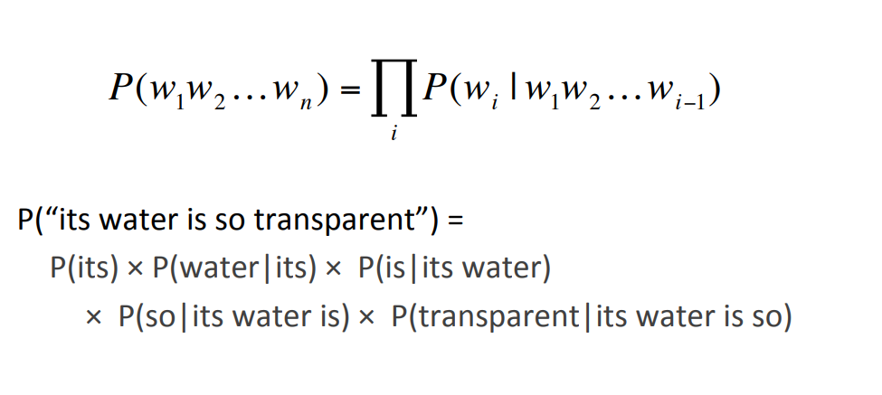
Example

Slide 8
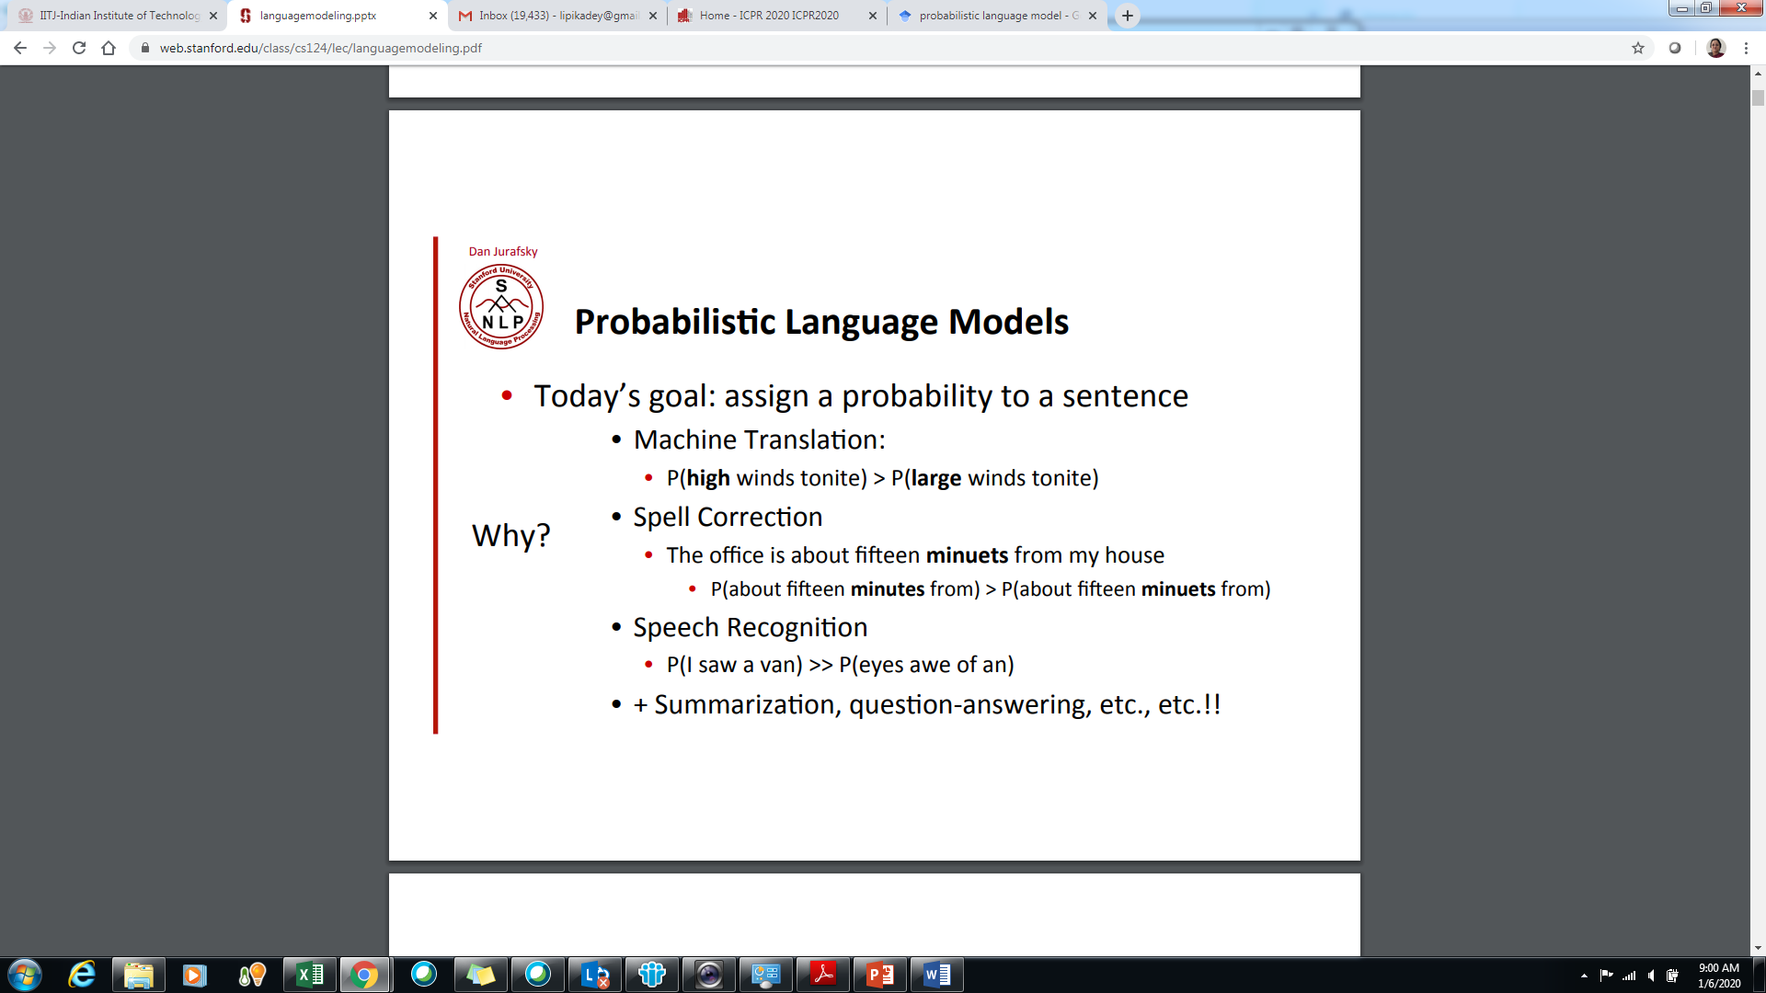
High probability sequences

Slide 9
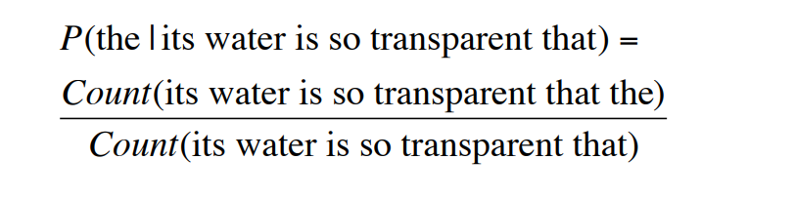
Estimating probabilities from corpus
Estimate from counts in corpus
P(w₁w₂…w_{n}) = Count_of (w₁w₂w₃…w_{n}) / Count_of (w₁w₂w₃…w_{n-1})
P(its water is so transparent that the) =
Impossible to get enough data

Slide 10
Predicting words to complete sequences
Given a sequence w₁w₂w₃…w_{n-1} – predicting next word w
Predicted word w = Maximum_Likelihood_EstimateP(w|w₁w₂w₃…w_{n-1})
Without enough data to compute probabilities – models are meaningless

Slide 11
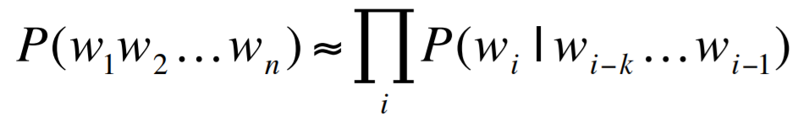
Ngram Models
Markovian Assumption – Not all n-1 previous words are required – limited data from the past can be used
Unigrams consider only one past word
P(w₁w₂w₃w₄) = P(w₂|w₁)*P(w₃|w₂)*P(w₄|w₃)
Bigrams consider only two past words
P(w₁w₂w₃w₄) = P(w₃ |w₁ w₂) * P(w₄|w₂w₃)
Trigrams consider only three past words
P(w₁w₂w₃w₄)= P(w₄ |w₁w₂w₃)

Slide 12
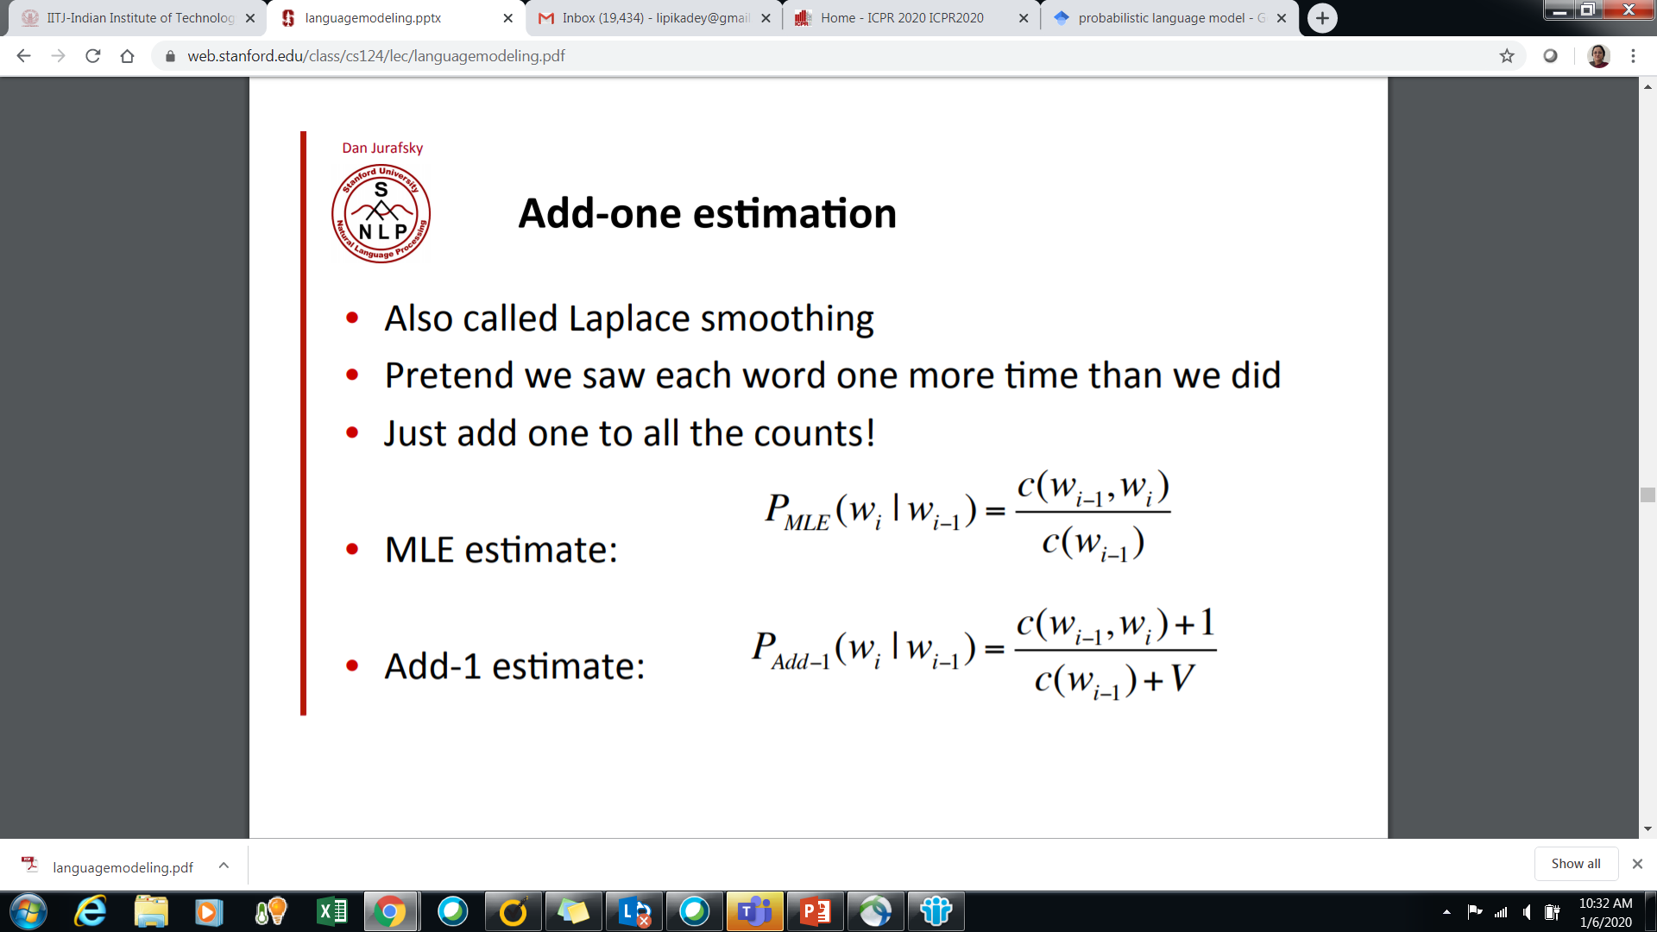
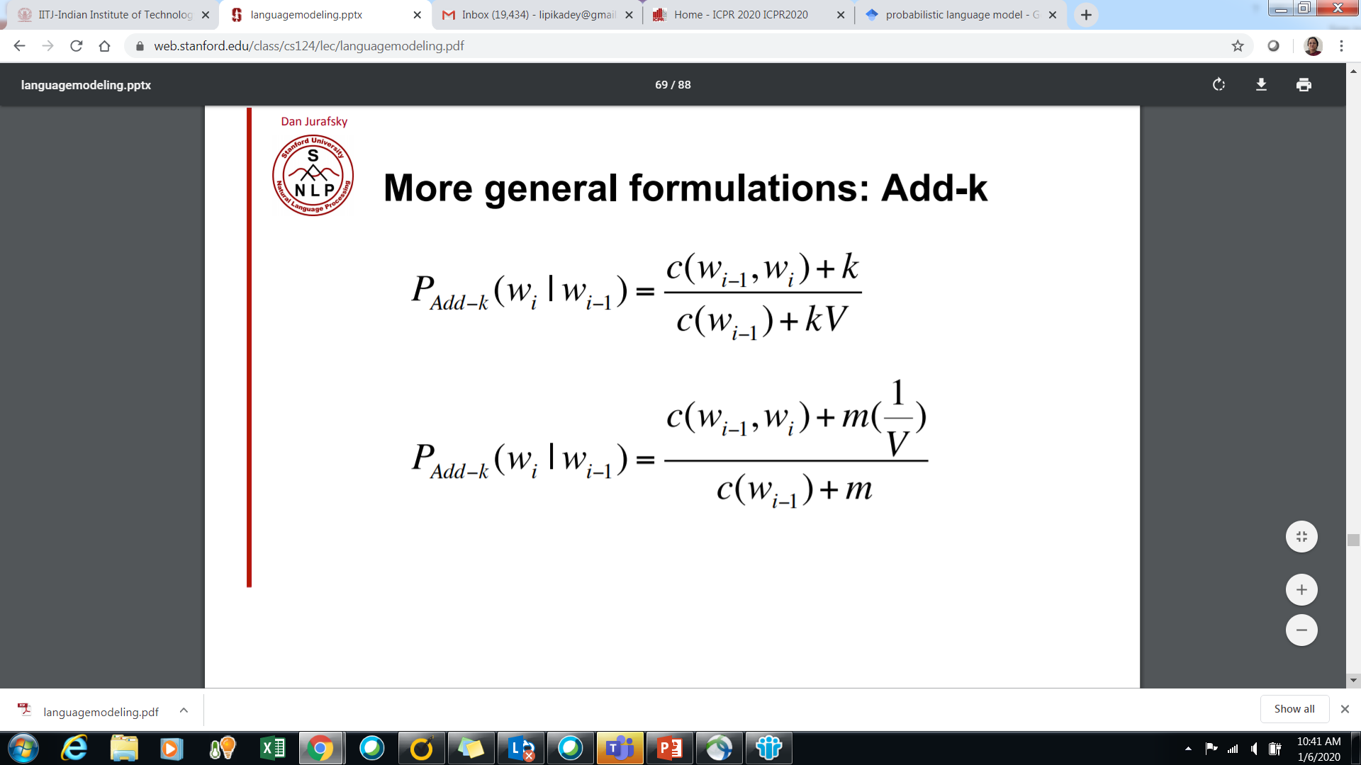
Laplacian smoothing

Slide 13
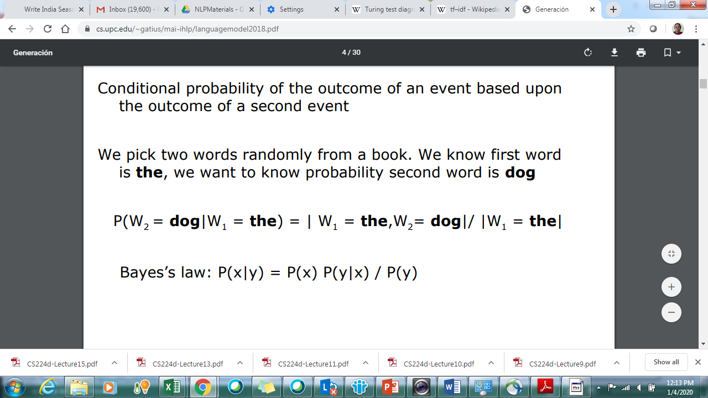
Conditional Probability

Slide 14
If you knew the future
Team A won the match and …………….
Team A won the match and ……………. charity
The-1 cat-2 sat-3 on-4 the-5 mat-6
Billi-1 chatai-2 par-3 baithi-4 hai-5

Slide 15
If you had to correct answer scripts
The course NLU is about learning to tell a story - Right or Wrong?
The course NLU teaches how text sequences are generated by a computer

Slide 16
If you wanted your computer to write your story
The student ………………..

Slide 17
WORD EMBEDDINGS
NEURAL LANGUAGE MODELS
LECTURE – 3RD MARCH, 2020

Slide 18
PAPERS - REFERENCES
1. Y. Bengio, R. Ducharme, P. Vincent. A neural probabilistic language model. Journal of Machine Learning Research, 3:1137-1155, 2003.
Implementation - https://towardsdatascience.com/skip-gram-nlp-context-words-prediction-algorithm-5bbf34f84e0c
https://towardsdatascience.com/word2vec-skip-gram-model-part-1-intuition-78614e4d6e0b
https://arxiv.org/pdf/1901.09785.pdf - a paper talking about evaluations of Word-embedding models

Slide 19
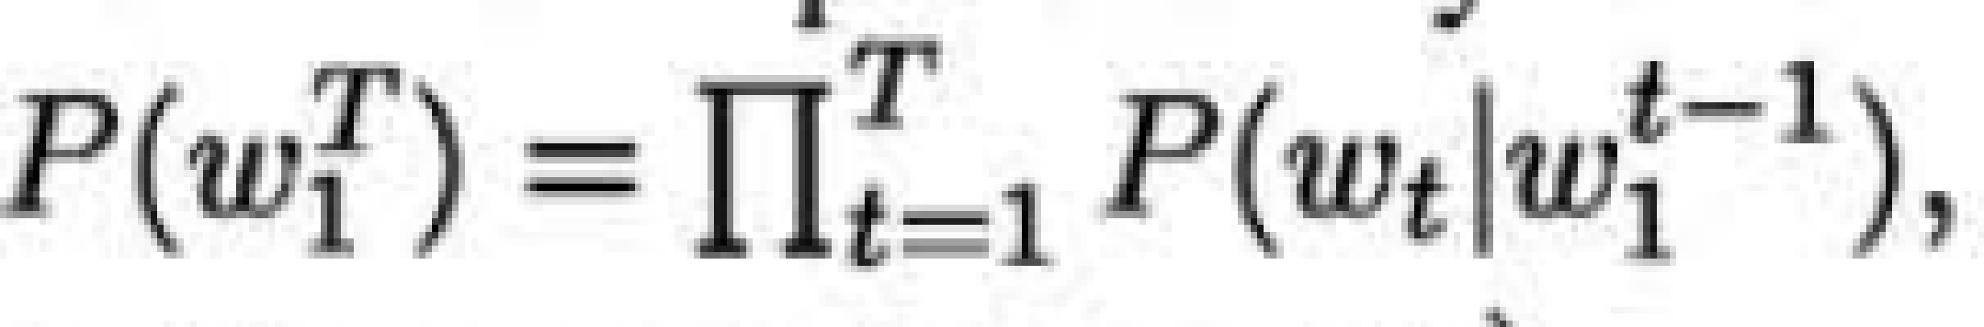
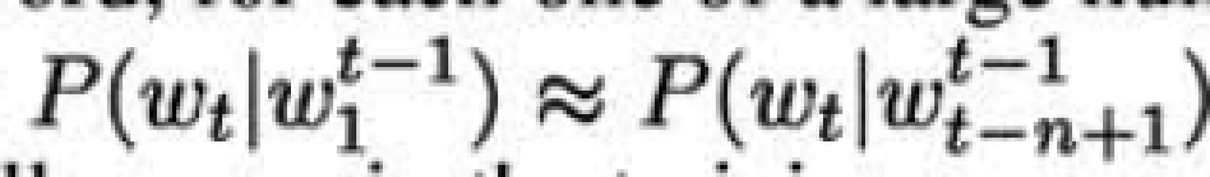
LANGUAGE MODEL – A REVIEW
A statistical model of language can be represented by the conditional probability of the next word given all the previous ones in the sequence
where w_{t} is the t-th word, and w_{i}^{j} denotes the subsequence (Wi, W_{i+1}, ... , W_{j-1}, W_{j}).
Assumed - Temporally closer words in the word sequence are statistically more dependent.
n-gram models construct tables of conditional probabilities for the next word, for each one of a large number of contexts, i.e. combinations of the last n - 1 words:

Slide 20
DIFFICULTIES FACED
Statistical language modeling attempted to learn the joint probability function of sequences of words in a language
The model suffers from Curse of dimensionality
Example : - if one wants to model the joint distribution of 10 consecutive words in a natural language with a vocabulary V of size 100,000
there are potentially 100000¹⁰ − 1 = 10⁵⁰ − 1 free parameters.

Slide 21
TESTING FOR NEW SENTENCES
Intrinsically difficult task without taking similarity of words into account
a word sequence on which the model will be tested is likely to be different from all the word sequences seen during training
Example : - Knowing that the following is a valid sentence - “The cat is walking in the bedroom”
It should be easy to understand that “A dog was running in a room” is almost as likely
Billi bedroom me tahal rahi hai
Kutta room me dour raha tha

Slide 22
DISTRIBUTED REPRESENTATION OF WORDS – GENERAL IDEA
Associate with each word in the vocabulary a distributed word feature vector - a real-valued vector in R^{m}
Express the joint probability function of word sequences in terms of the feature vectors of these words in the sequence
Learn simultaneously the word feature vectors and the parameters of that probability function
m is dimension of vector space – much smaller than size of vocabulary

Slide 23
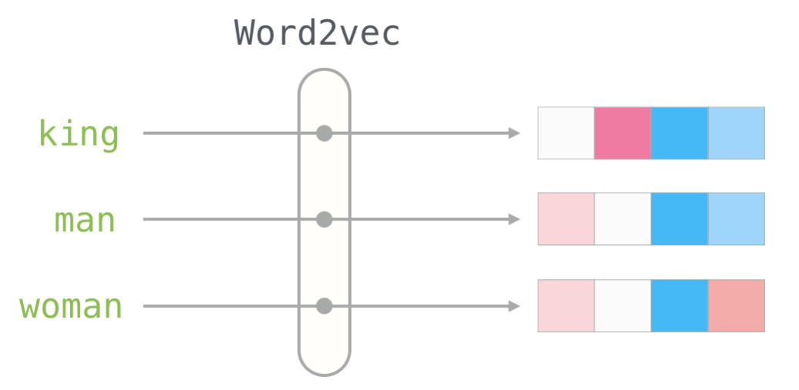
Word2Vec – If words could be vectors!
It would be possible to compute Euclidean distances between words as a measure of similarity
King : queen :: man : woman - doctor : nurse is not equal to man : woman
https://jalammar.github.io/illustrated-word2vec/

Slide 24
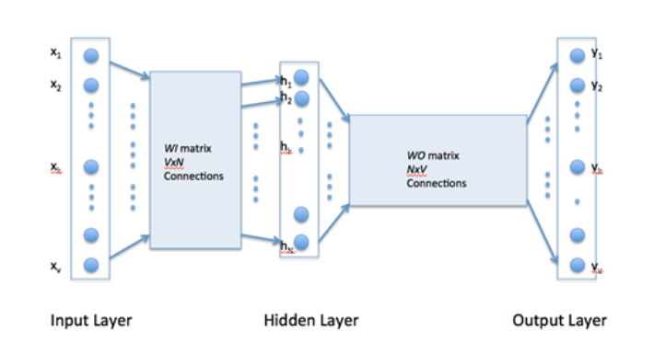
Architecture for learning Word Vectors
The second matrix encodes the representation of words

Slide 25
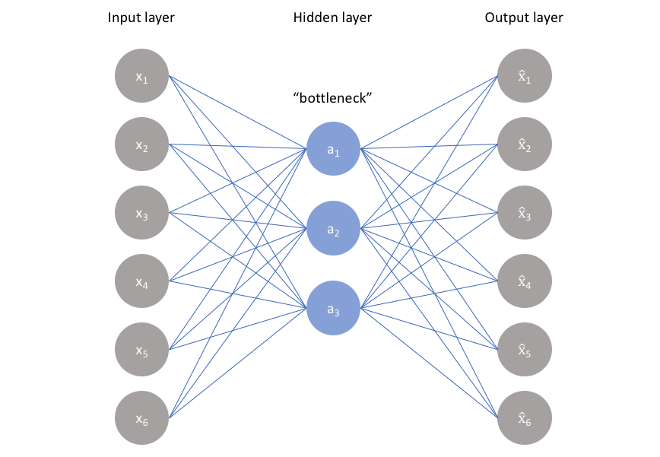
The ideal autoencoder model balances the following:
Sensitive to the inputs enough to accurately build a reconstruction
Insensitive enough to the inputs that the model doesn't simply memorize or overfit the training data

Slide 26
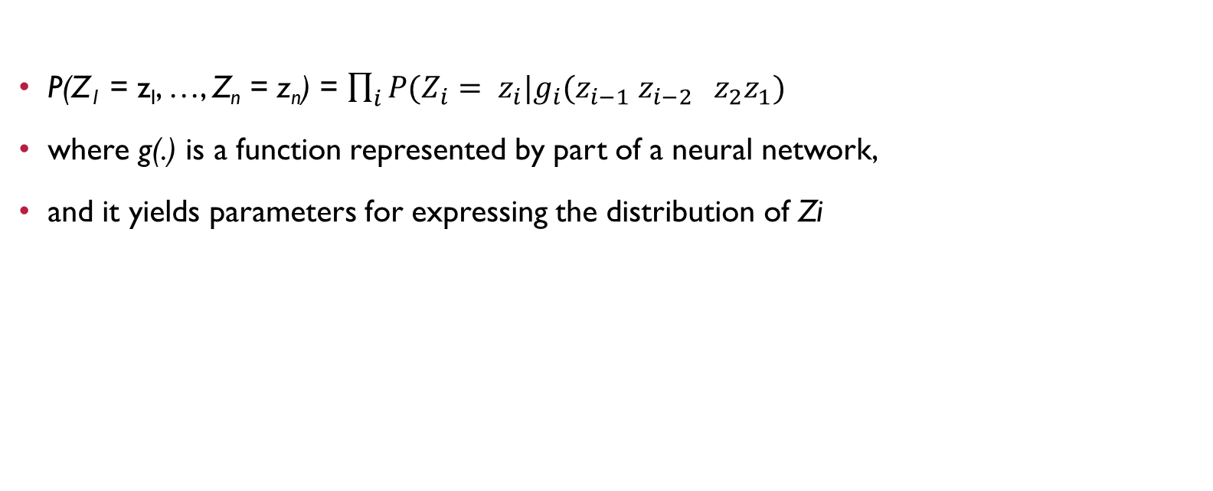
THE MATHEMATICS BEHIND IT

Slide 27
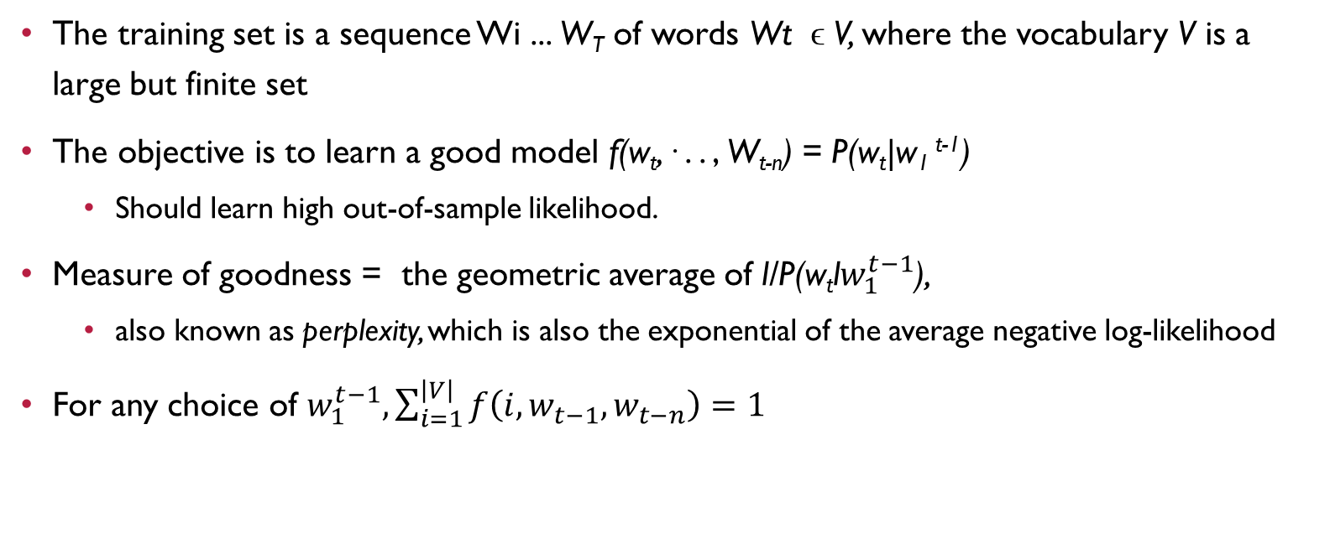
TRAINING THE WORD VECTORS

Slide 28
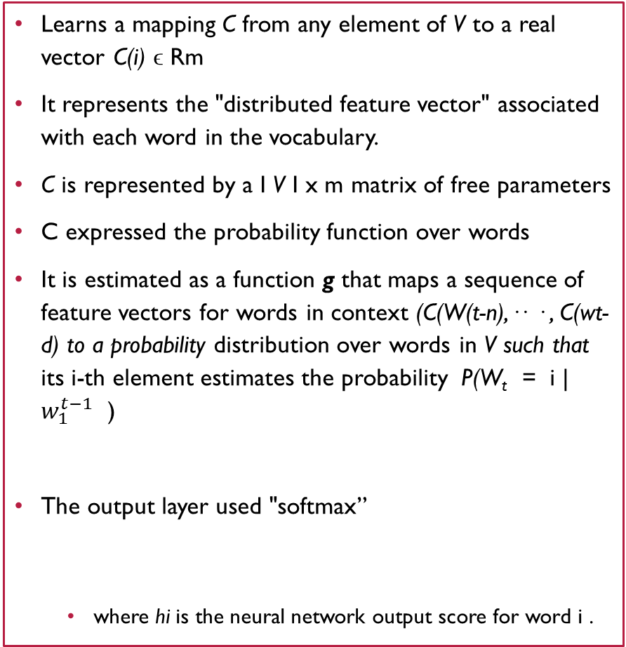
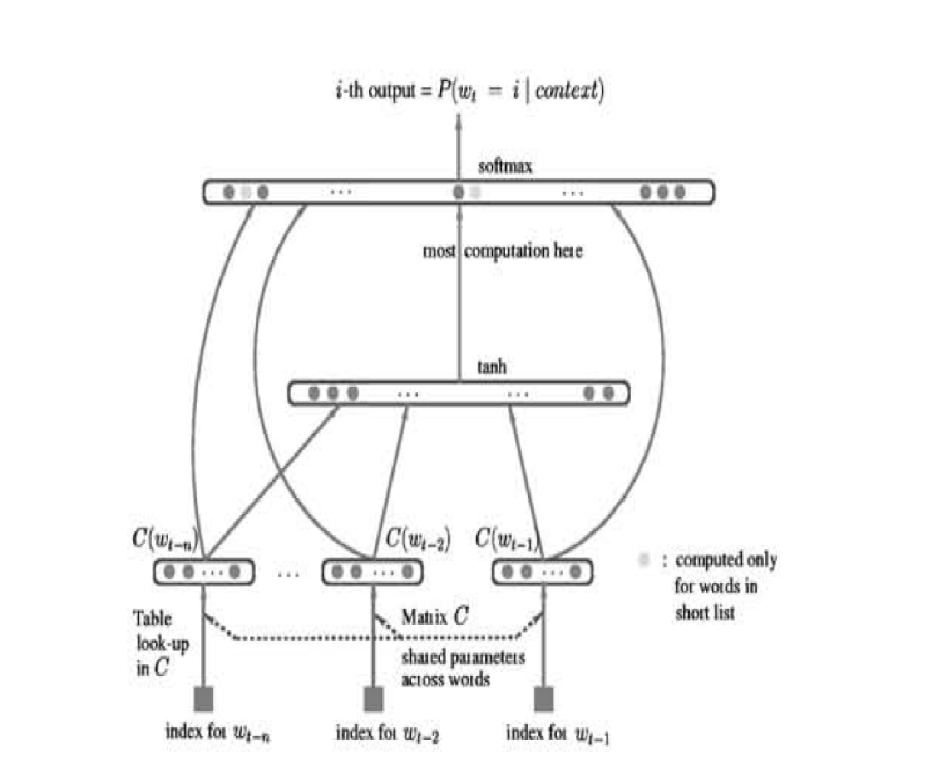
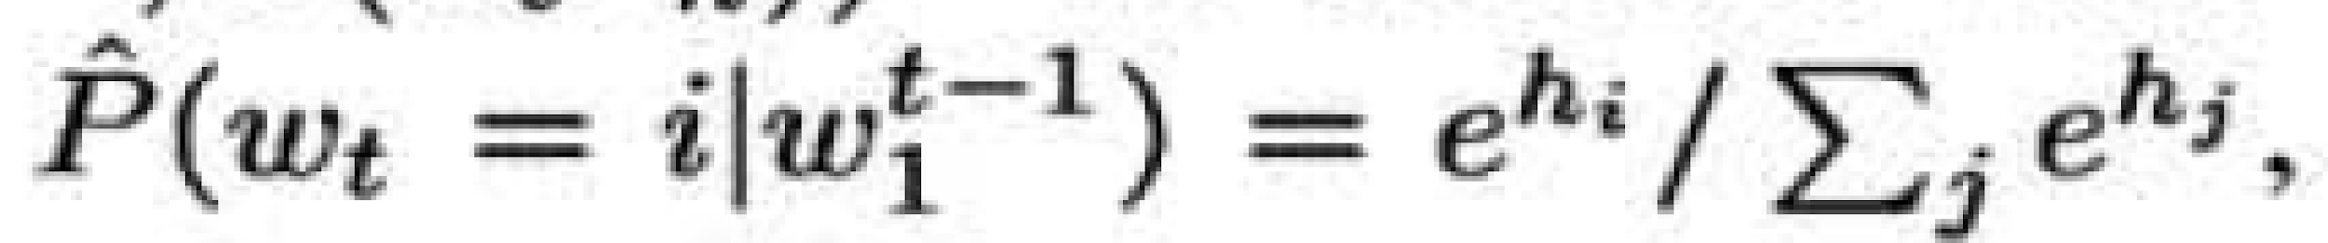
DIRECT ARCHITECTURE

Slide 29
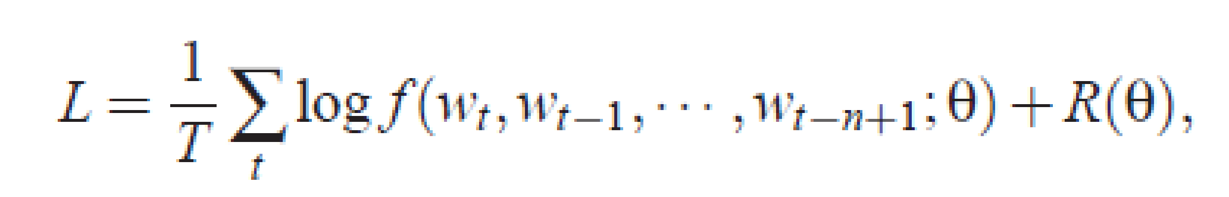
BUILDING THE NEURAL MODEL
Training looks for the ϴ that maximizes the training corpus penalized log-likelihood

Slide 30
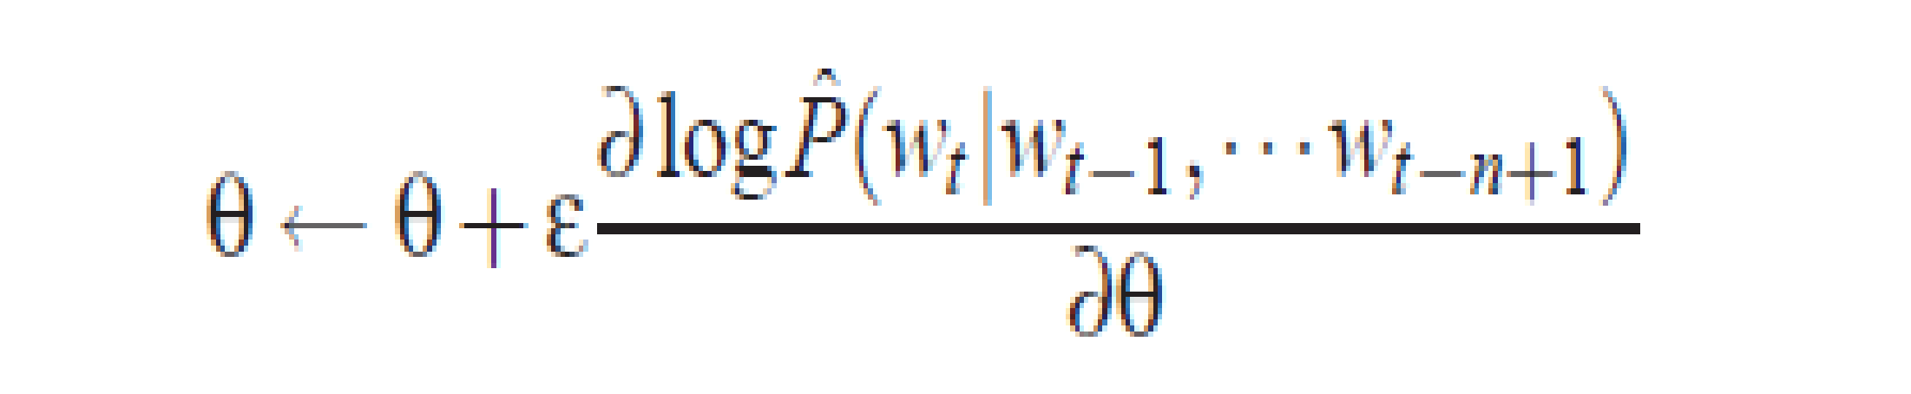
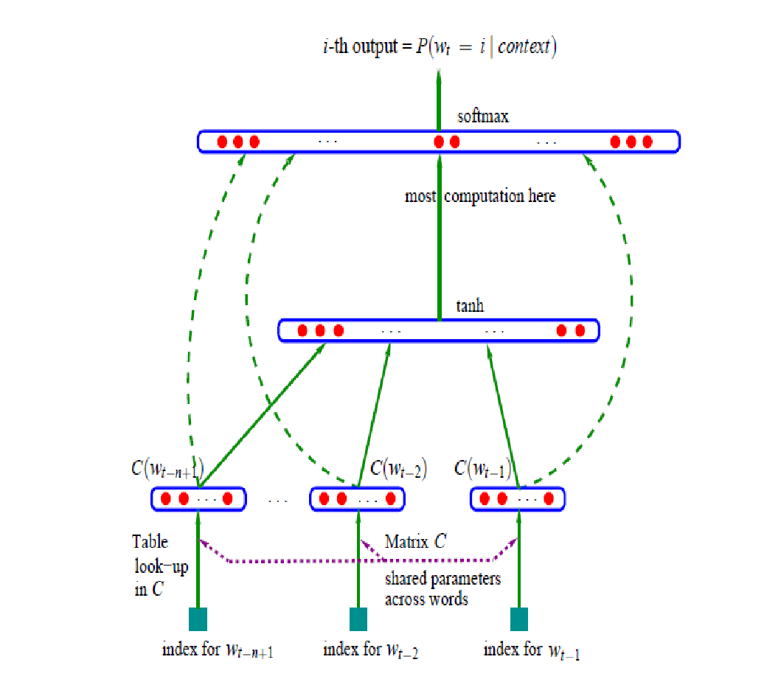
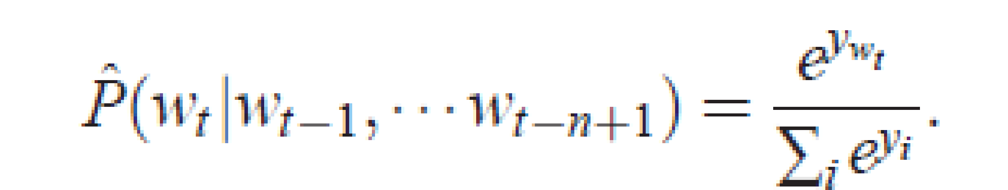
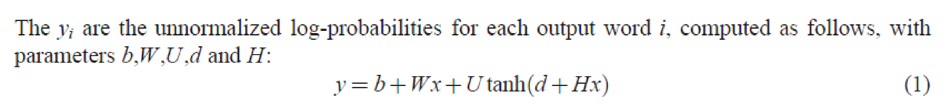
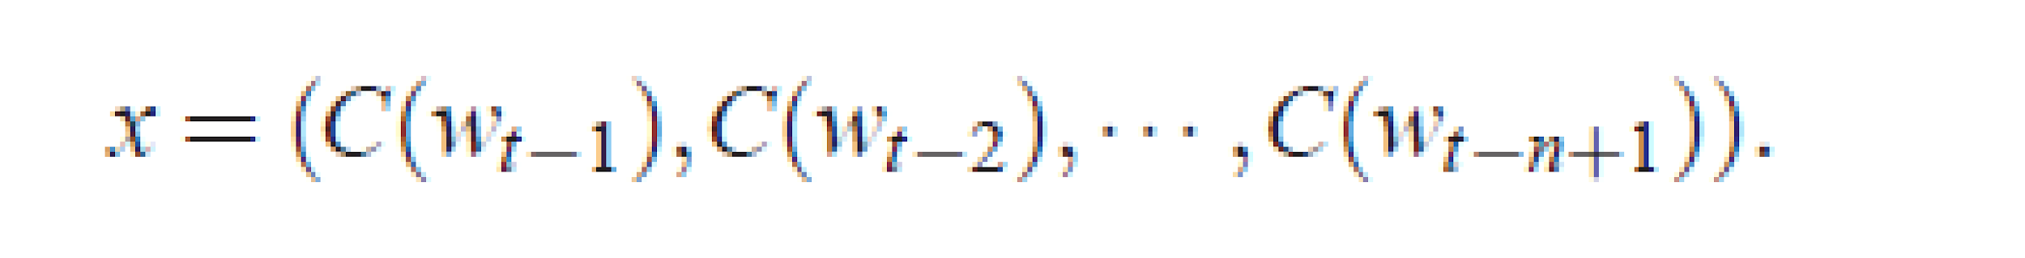
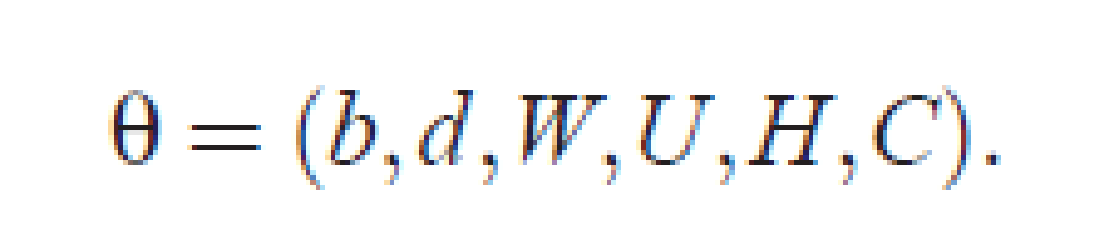
Parameters of the model
Parameters for only those words that appear in a context have to be updated

Slide 31
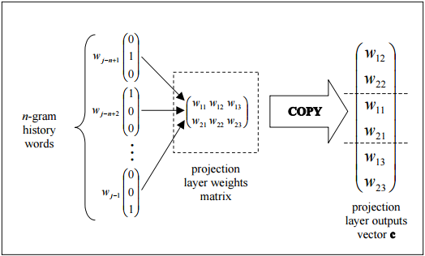
PROJECTION LAYER
The projection layer is shared such that for contexts containing the same word multiple times, the same set of weights is applied to form each part of the projection vector
This organization effectively increases the amount of data available for training the projection layer weights since each word of each context training pattern individually contributes changes to the weight values.

Slide 32
LIMITATIONS OF THE ABOVE MODEL
Number of output units = |V|
For every training sequence – the total number of weights to be learnt
Q = N * D + N * D * H + H * V
N – the context length is to be fixed before
H * V is the dominating factor – hence the size of vocabulary was restricted

Slide 33
NEW LOG LINEAR MODELS
Minimize computational complexity
Most of the complexity is caused by the non-linear hidden layer in the model
Objective was to explore simpler models that might not be able to represent the data as precisely as neural networks, but can possibly be trained on much more data efficiently
For measuring the quality of the resulting vector representations, it was checked whether similar words tend to be close to each other
Please note that words can have multiple degrees of similarity
Computer, Computing, Computation
King, queen, palace, royalty

Slide 34
SKIP-GRAM MODEL
Feedforward Neural Network with the projection layer shared for all words - all words get projected into the same position (their vectors are averaged)
A bag-of-words model as the order of words in the history does not influence the projection.
Also use words from the future
Log-linear classifier with four future and four history words at the input
Training criterion - Correctly classify the current (middle) word

Slide 35
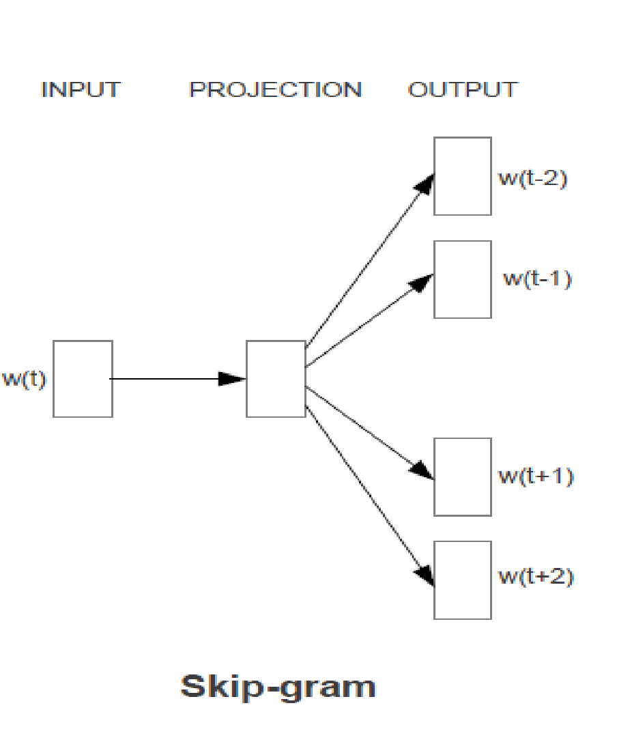
Train a simple neural network with a single hidden layer to perform a certain task
However - that neural network is not going to be used
Goal is actually just to learn the weights of the hidden layer
These weights will represent the “word vectors”

Slide 36
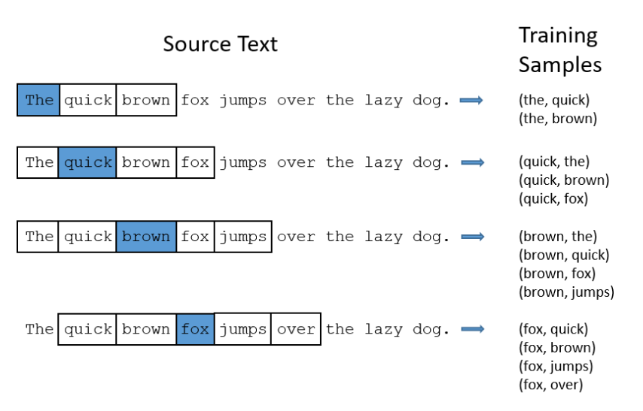
THE FAKE TASK
Train a neural network to do the following
Given a specific word in the middle of a sentence (the input word) – if we pick one nearby word at random - the network will tell us the probability for every word in our vocabulary of being the “nearby word” that we chose
Nearby – size of window

Slide 37
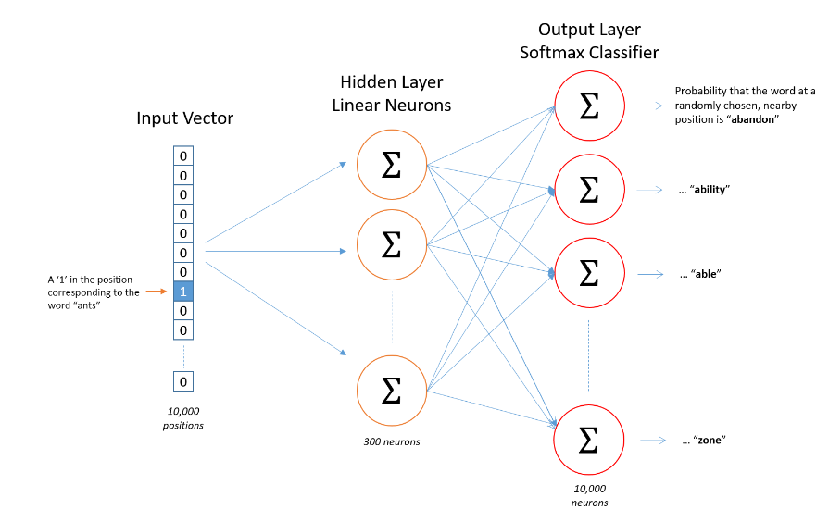
The Hidden Layer
Suppose we’re learning word vectors with 300 features – then the hidden layer is going to be represented by a weight matrix with 10,000 rows and 300 columns

Slide 38
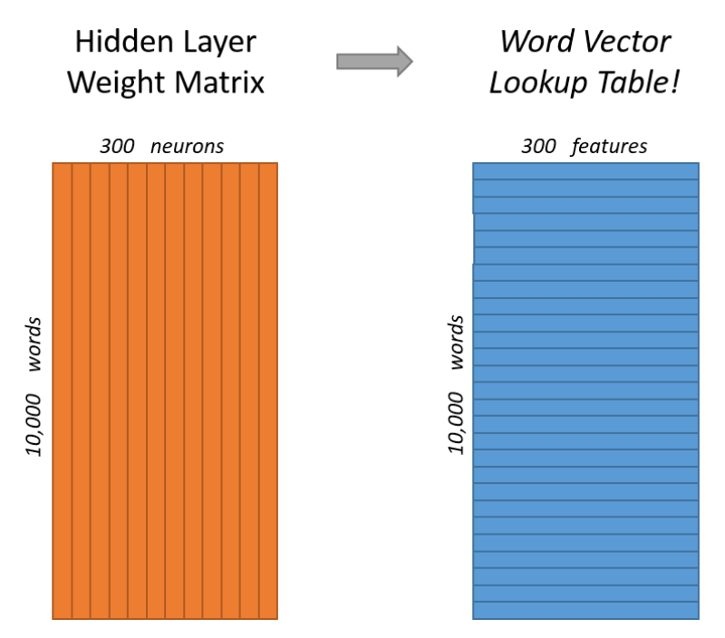
The Output Layer
The 1 x 300 word vector for an input word gets fed to the output layer – which is a softmax regression classifier
Each output neuron will produce an output between 0 and 1, and the sum of all these output values will add up to 1
Specifically, each output neuron has a weight vector which it multiplies against the word vector from the hidden layer
It then applies the function exp(x) to the result and divides this by the sum of the results from all 10,000 output nodes

Slide 39
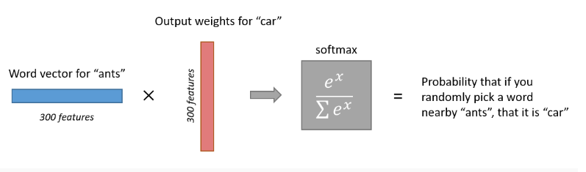
PROBABILITY OF A RANDOM “NEARBY” WORD

Slide 40
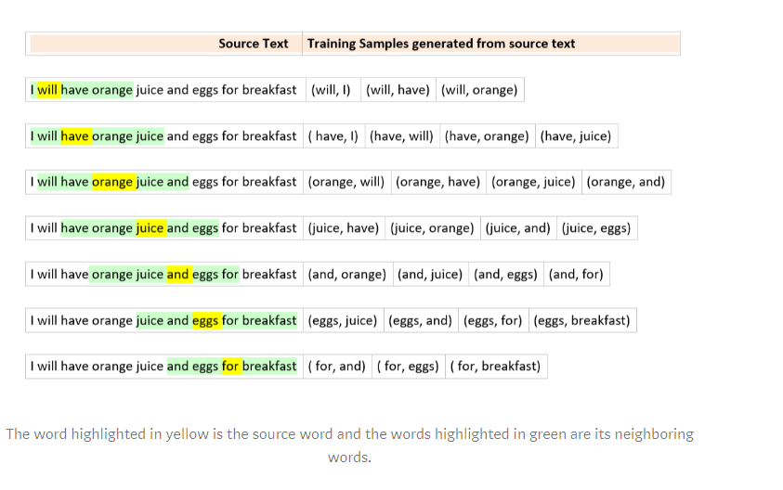
TRAINING SKIP-GRAM MODELS
We will complete the forward pass for all 4 target words ( have, orange, and, eggs).
Calculate the errors vectors[1xV dimension] corresponding to each target word. – so 4 1xV error vectors
Perform an element-wise sum to get a 1xV vector
The weights of the hidden layer will be updated based on this cumulative 1xV error vector.
The back propagation for training samples corresponding to a source word is done in one back pass
If the target word is juice and window size is 2
its neighboring words will be ( have, orange, and, eggs)
Input and target word pairs will contain (juice, have), (juice, orange), (juice, and), (juice, eggs)

Slide 41
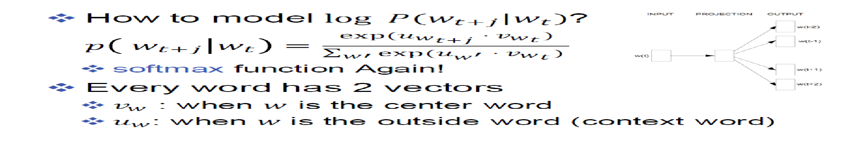
RECAPITULATION
I love cats and dogs but not birds as pets
V = cats
P = I
P = love
P = and
P = dogs
U vectors
Vector for a | Vector for and | Vector for cats |  | Vector for dogs |  | Vector for i |  |  | Vector for Zebra
Vector for a | Vector for and | Vector for cats |  | Vector for dogs |  | Vector for i |  |  | Vector for Zebra
V vectors

Slide 42
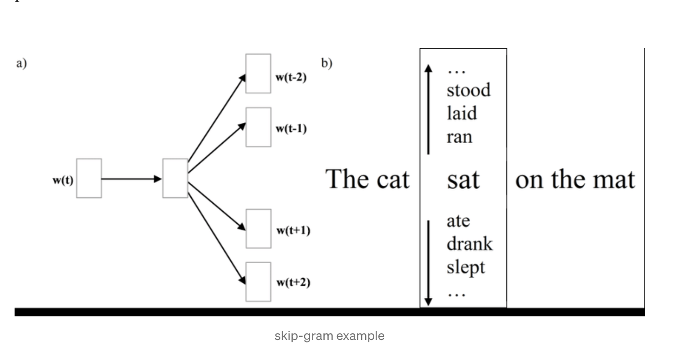
Skip gram Prediction

Slide 43
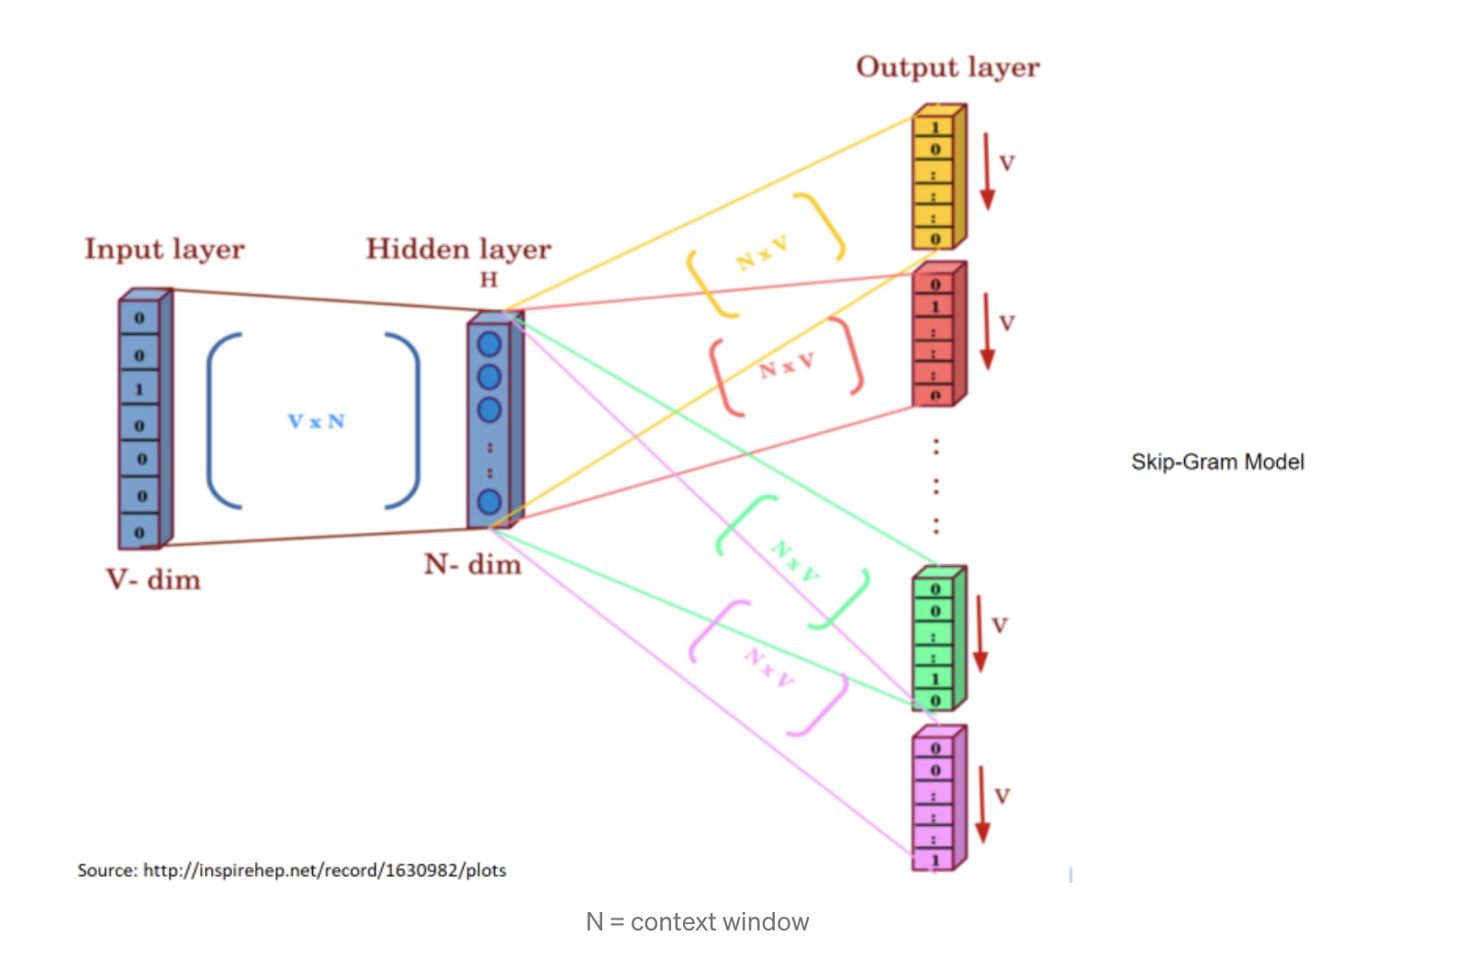

Slide 44
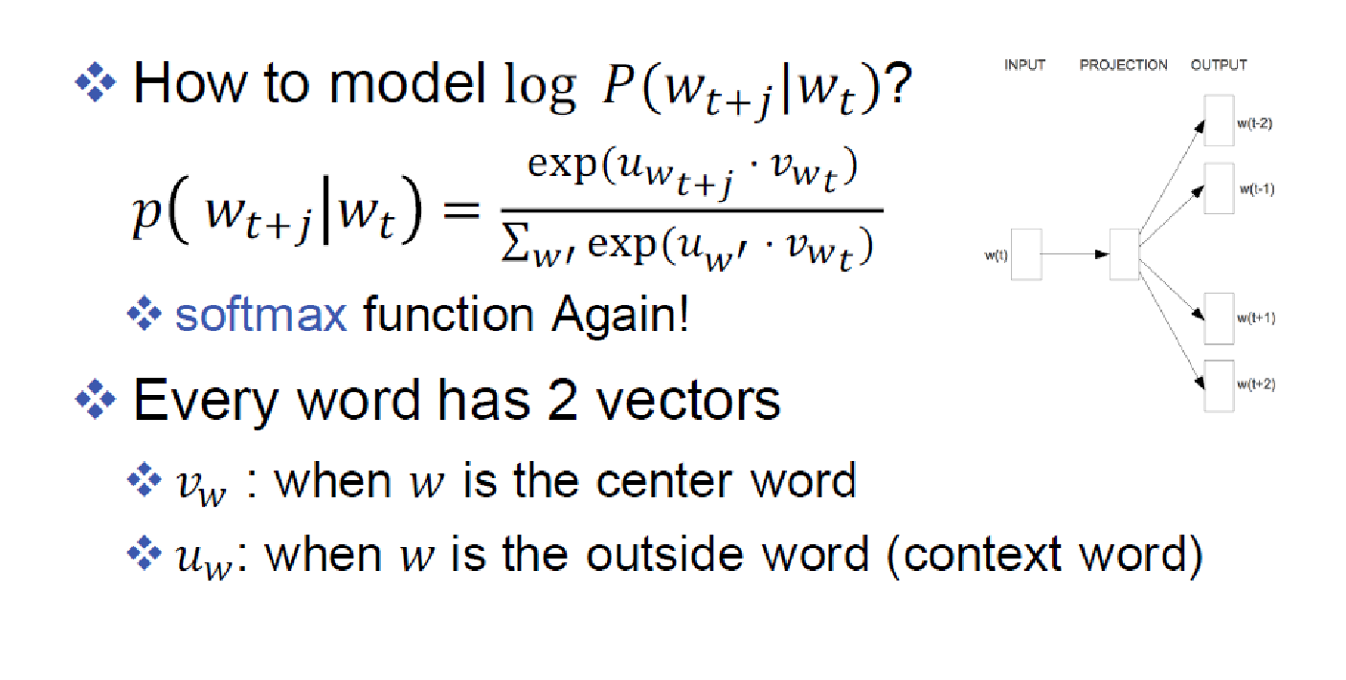

Slide 45
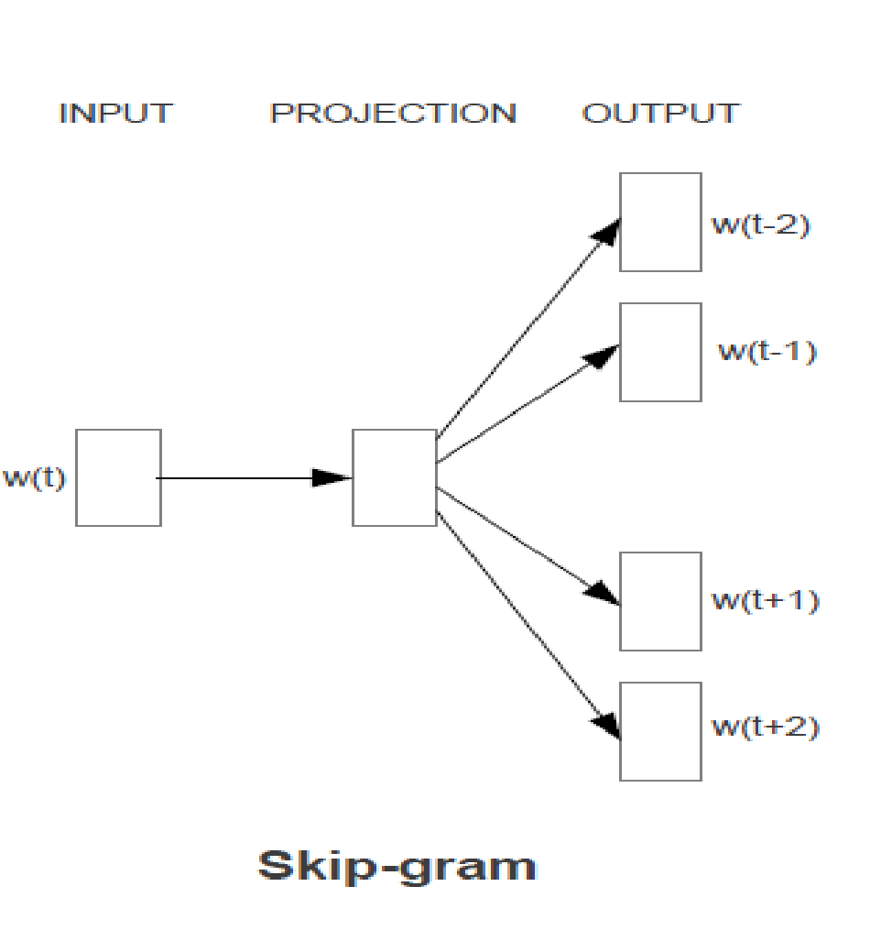
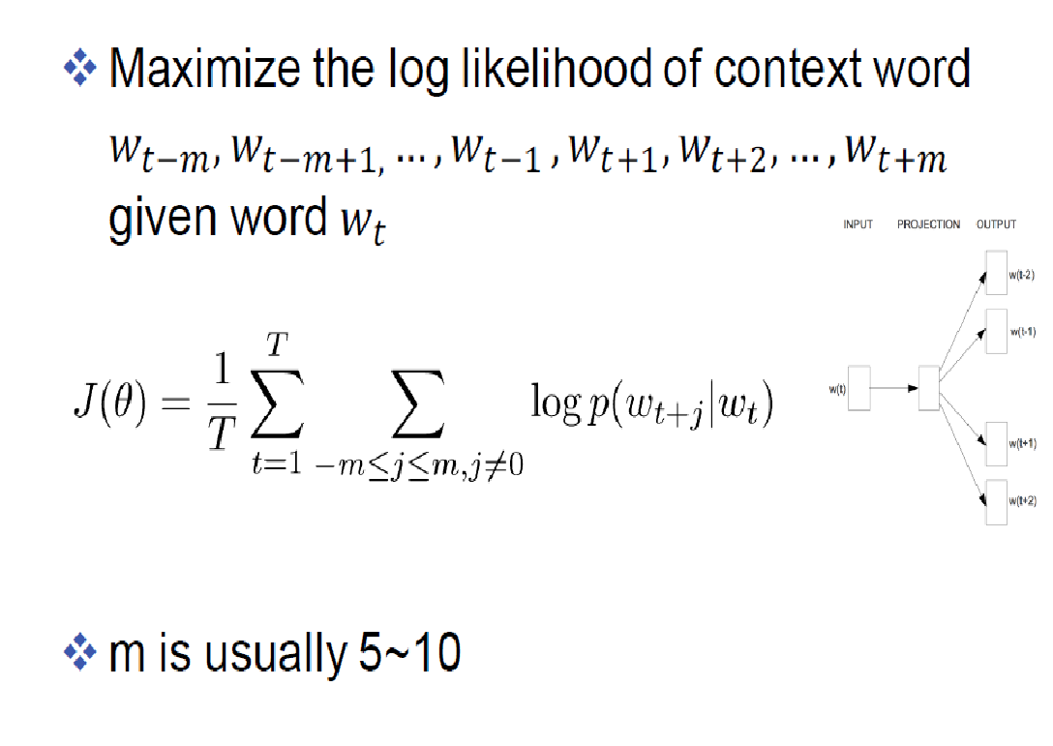
Joint prediction of all surrounding words

Slide 46
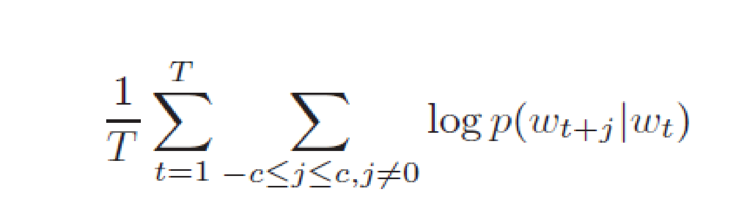
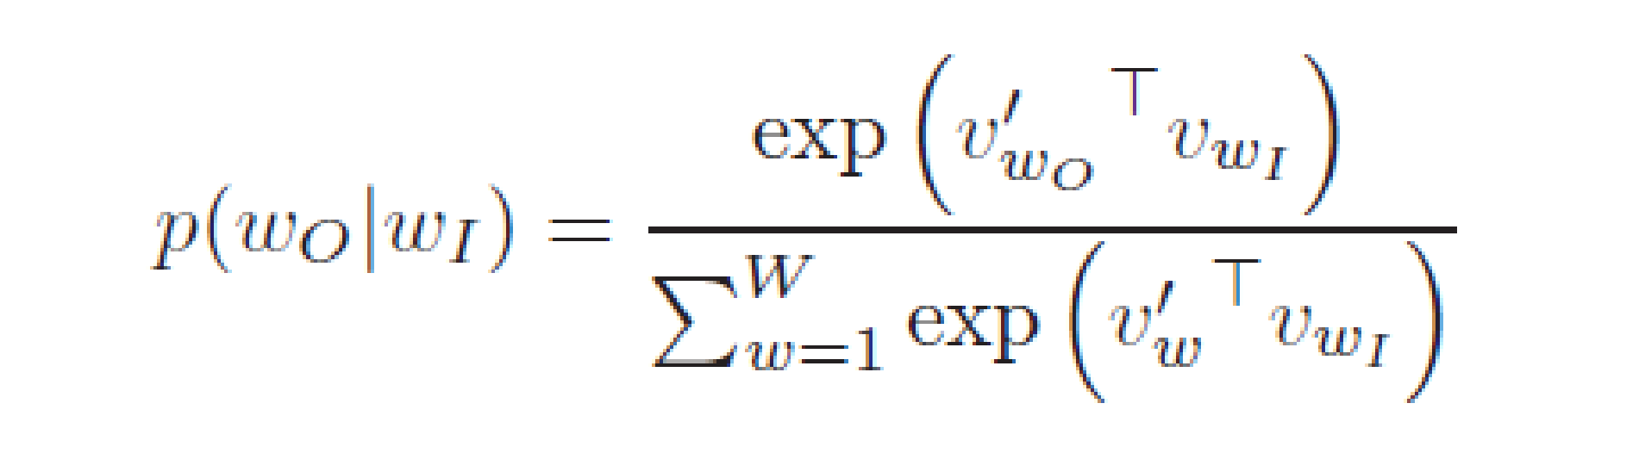
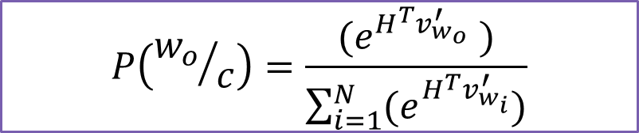
SOFTMAX COMPUTATION FOR SKIP-GRAM
Given a sequence of training words w₁, w₂, …, w_{T} - Maximize average Log Probability
Large values of context c – will yield more training samples – more computing time
Having |V| output nodes is not practical

Slide 47
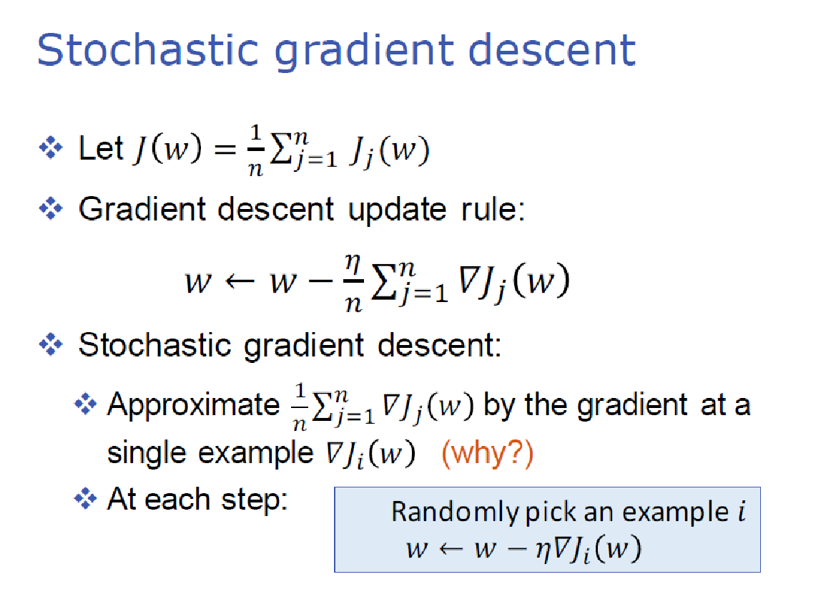
https://towardsdatascience.com/skip-gram-nlp-context-words-prediction-algorithm-5bbf34f84e0c

Slide 48
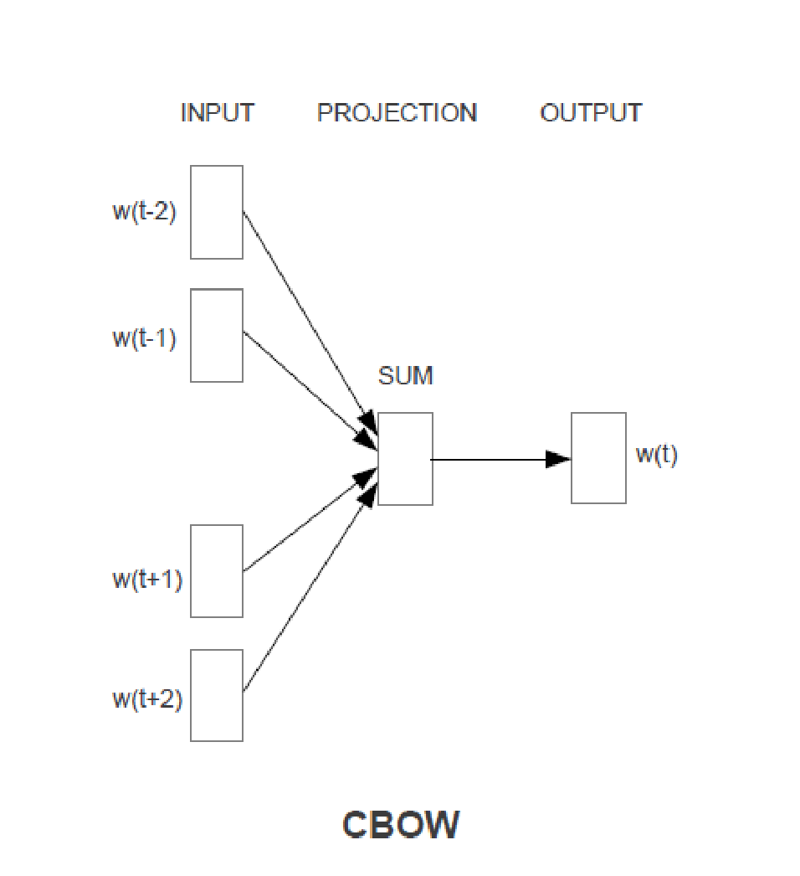
CONTINUOUS BAG OF WORDS MODEL
The fake task in CBOW is somewhat similar to Skip-gram
Take a pair of words and teach the model that they co-occur but instead of adding the errors we add the input words for the same target word
If we have 4 context words for a single target word, we will have 4 1xV input vectors.
Each will be multiplied with the VxE hidden layer returning 1xE vectors.
All 4 1xE vectors will be averaged element-wise to obtain the final activation which then will be fed into the softmax layer

Slide 49
COMPARISON
Skip-gram: works well with a small amount of the training data, represents well even rare words or phrases
CBOW: several times faster to train than the skip-gram, slightly better accuracy for the frequent words.
Step by Step understanding of weight learning
https://thinkinfi.com/continuous-bag-of-words-cbow-single-word-model-how-it-works/

Slide 50
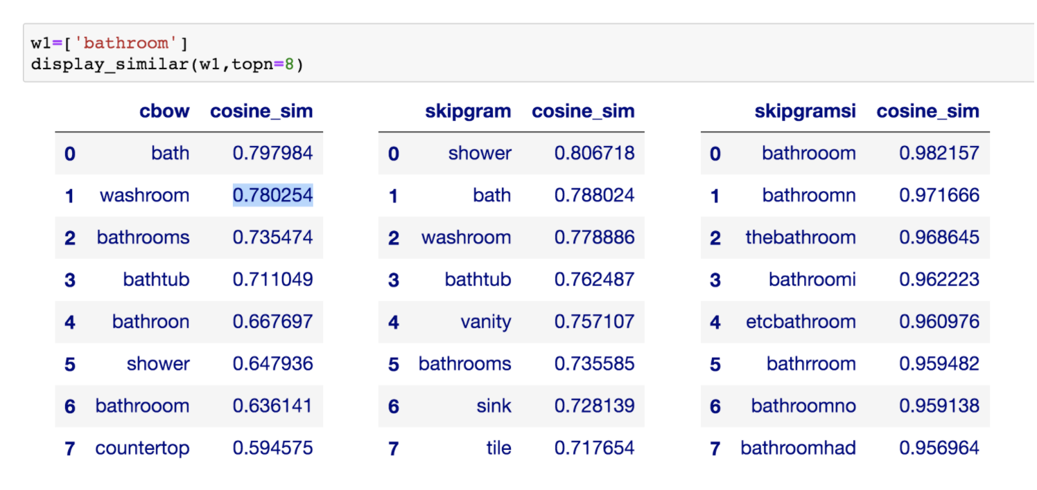

Slide 51
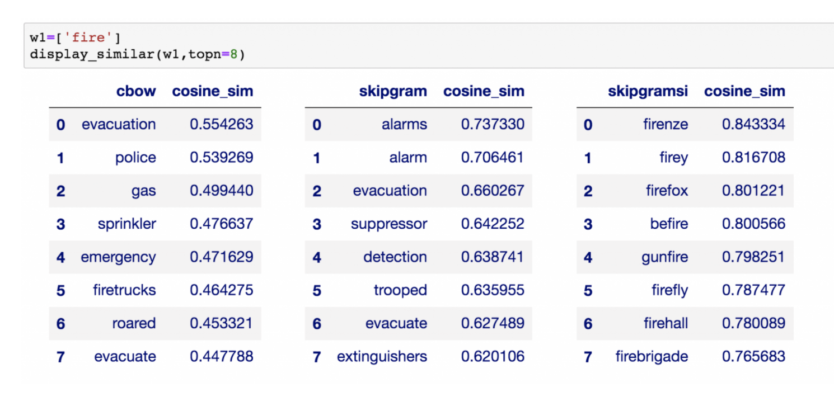

Slide 52
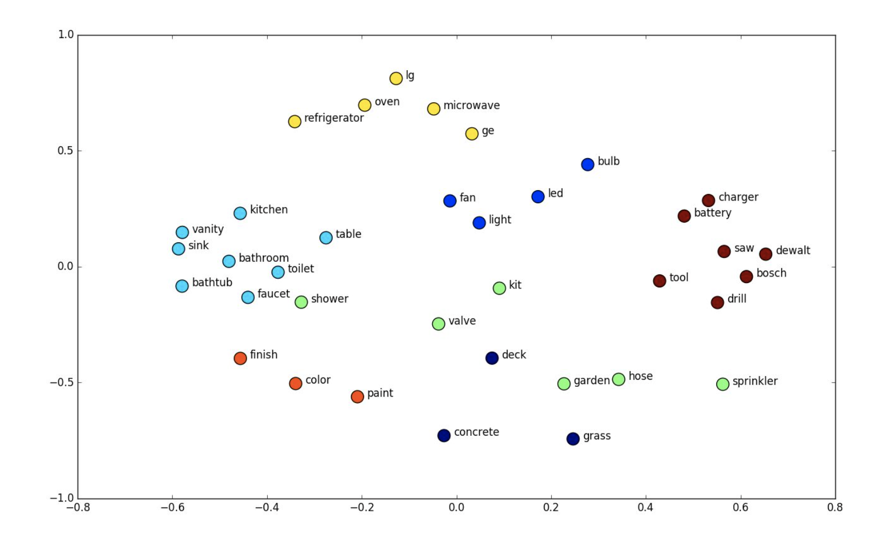
Distribution of words in N (50/300/500) dimensional space - visualization
2 D plot - using PCA -
https://cs.stanford.edu/people/karpathy/tsnejs/csvdemo.html

Slide 53
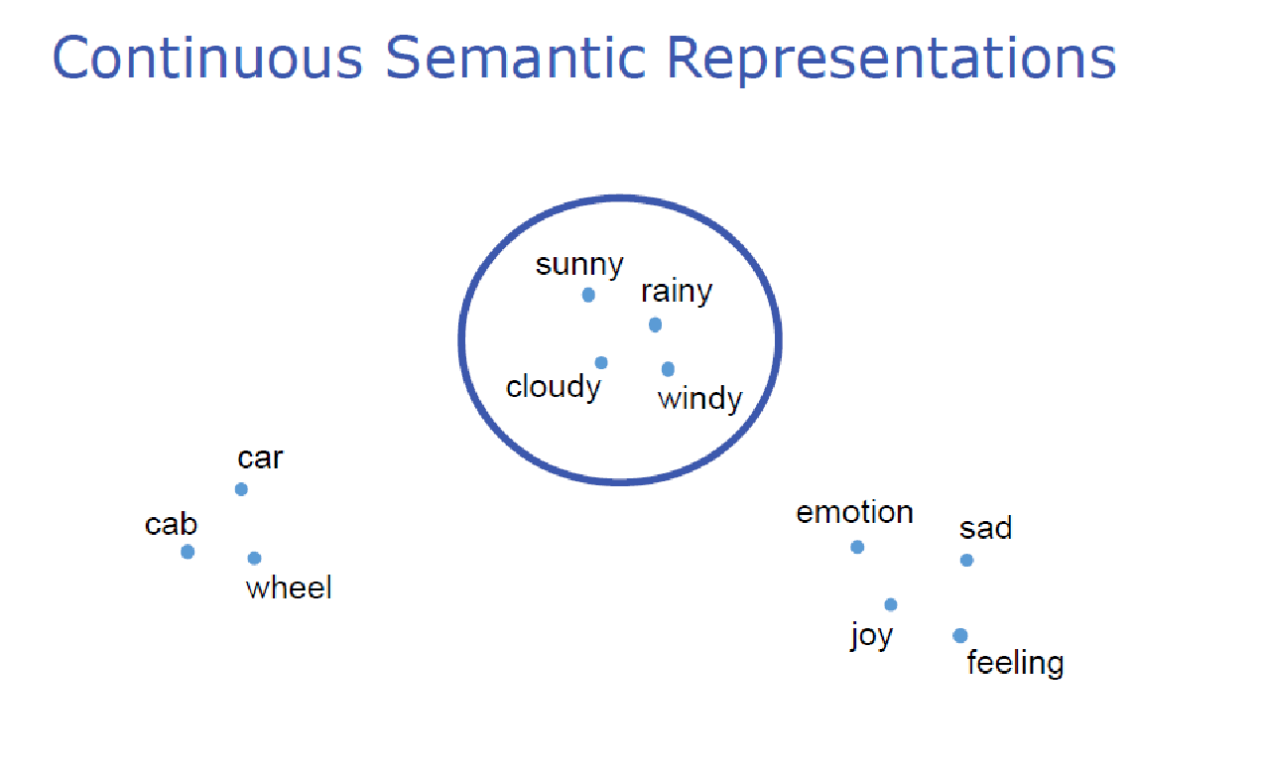
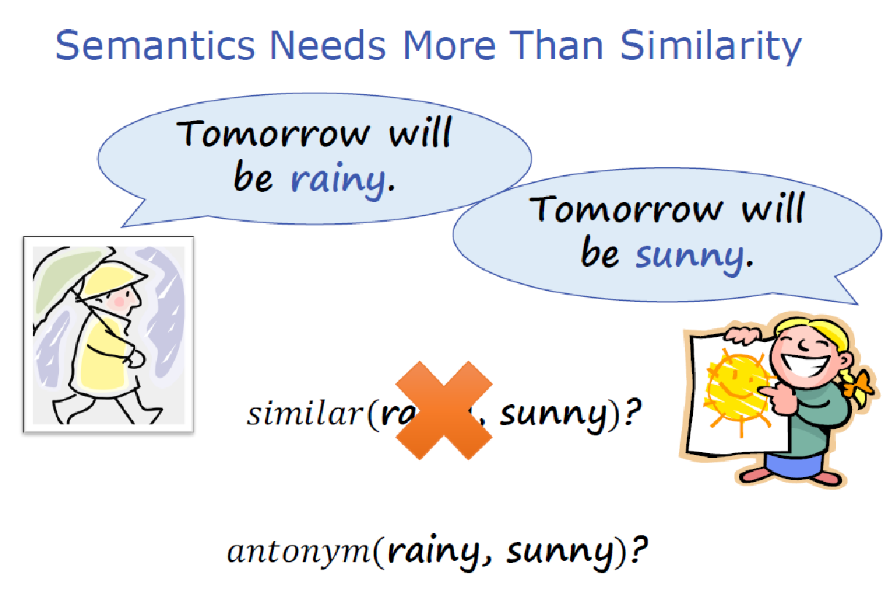

Slide 54
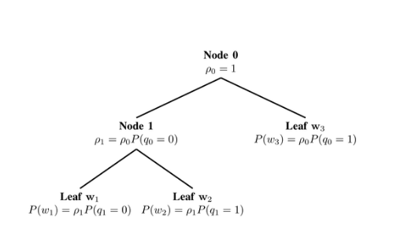
HIERARCHICAL SOFTMAX
All words are at leaf nodes
The path is a sequence of words (context) that lead to that word
P(w/context) = path cost of reaching that word taking the context as a path
At each node – we need the Probability of branching right or left
A Binary Tree at the Output Layer

Slide 55
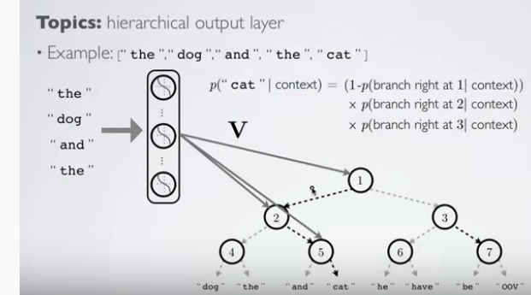
Each internal node in the tree is a sigmoidal output in the NN – but the number of probability computation would be less
P(“cat”/”The””dog””And””The”) =
P(branch left at 1|context)
X P(branch right at 2/context)
X P(branch right at 5/context)
P(“cat”/”The””dog””And””The”) =
1 - P(branch right at 1|context)
X P(branch right at 2/context)
X P(branch right at 5/context)

Slide 56
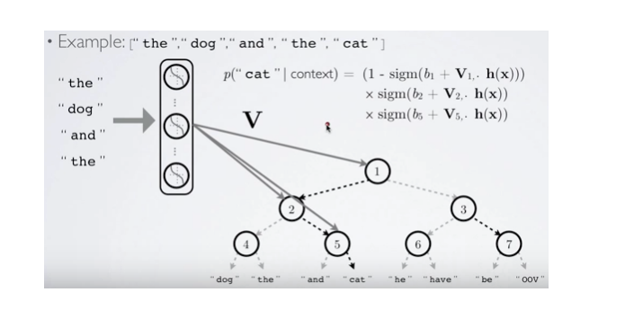
EXAMPLE
V1
V2
V5

Slide 57

HOW TO GENERATE THE TREE?
Can generate a randomly generated tree
Performance will not be good
Can use WordNet
Using most Frequent Sense – one representation per word

Slide 58

VECTOR ALGEBRA ON WORDS

Slide 59

Today is a very ... day
Which model?
It …. …. delightful …. ….
Which model?
Which one is most likely? Why?
It was a delightful day yesterday
It was a delightful lunch yesterday
It was a delightful program yesterday

Slide 60
OTHER WAYS TO REDUCE COMPUTATIONAL COMPLEXITY - NEGATIVE SAMPLING
Subsampling frequent words to decrease the number of training examples.
Negative Sampling - Modifying the optimization objective – such that each training sample updates only a small percentage of the model’s weights
Subsampling frequent words and applying Negative Sampling not only reduces the compute burden of the training process, but also improves the quality of the resulting word vectors

Slide 61

SUBSAMPLING - 1
Sampling rate determines Probability with which to keep a given word in the vocabulary
Sampling parameter – 0.001 (say)
For w_{i} – let z(w_{i}) – denote its relative frequency in the corpus
If word “house” occurs 1000 times in a corpus of 1 billion words – what is the probability that it will be retained for training?
What should be the frequency of a word to ensure that it has 50% chance of being retained in training?

Slide 62

SUBSAMPLING - 2
Probability of discarding a word for training
Higher the frequency – lesser number of times it will be picked up for training
Vector representation of frequent words do not change much
t = 10⁻⁵ ⁻ typical value of threshold

Slide 63
NEGATIVE SAMPLING
To train a Neural Network for a corpus of 10⁶ words, where each word is represented by 300 dimensional vector – 300*10^6 weights have to be updated for each training
Negative sampling
During each training sample only a small percentage of these weights are modified
Example - While training the network on the word pair (“fox”, “quick”) – if desired output is quick
Output neuron corresponding to “quick” should be 1
All other neurons should output a 0
Negative sampling suggests – rather than correcting all weights – update the weights for a small number of “negative words” to output 0 and the weight for the “positive” word (i.e. “quick”)
Small – Typically 5 to 20

Slide 64

SELECTING NEGATIVE SAMPLES
Negative samples are selected using a “unigram distribution”
More frequent words are more likely to be selected as negative samples
From earlier example – Probability of “house” getting selected for weight adjustment is proportional to its frequency
 | Old formula | New formula
The | 0.4 | 0.35922
Dog | 0.166667 | 0.213593
How does it affect?
“The dog and the cat” - corpus

Slide 65

LEARNING PHRASE REPRESENTATION
A pair of words wi and wj constitutes a phrase if the score is positive
Run 2 to 4 times with decreasing threshold to get longer phrases
New York
Boston Herald
New York City
New York Times
These phrases are then treated as a linked word – and their vectors learnt

Slide 66

ANALOGICAL REASONING - TESTING FOR GOODNESS OF WORD VECTORS
Given the first three phrases – predict the fourth phrase

Slide 67


COMPARATIVE RESULTS [3]

Slide 68

COMPARISONS

Slide 69
For more details on implementation and Learning functions
https://necromuralist.github.io/Neurotic-Networking/posts/nlp/training-the-cbow-model/

Slide 70
GLOVE VECTORS
Objective - produce linear directions of meaning with global log-bilinear regression models
Uses weighted least squares model that trains on global word-word co-occurrence counts
Makes efficient use of statistics

Slide 71
CONTEXT - CO-OCCURRENCE MATRIX
X – matrix that stores Word-Word co-occurrence within a pre-defined context
X_{ij} = number of times word j occurs in the context of word i.
Compute probability of word j occurring in the context of word i
P_{ij} = P(j/i) = X_{ij} / X_{i}

Slide 72
HOW MEANING IS EXTRACTED FROM COOCCURRENCE PROBABILITIES
Let i = ice and j = steam be two words for which we want to test closeness of meaning
Relationship of these words can be determined by studying the ratio of their co-occurrence probabilities with various other probe words k
If k = water – then it is related to both I and j equally strongly
If k = solid – then it is related more strongly to ice than steam
If k = gas – then it is related more strongly to steam then ice
If K = fashion – then it is related to neither

Slide 73

EXAMPLE – VALUES FROM A THERMODYNAMICS CORPUS
Let us look at ratios of co-occurring probabilities

Slide 74




ENCODING LINEARITY OF WORD VECTOR REPRESENTATIONS
A Function that encodes the difference between two words
A Function that encodes the difference between two probe words

Slide 75

In the Vector space

Slide 76


A LITTLE MATH MANIPULATION

Slide 77



THE MODEL
Not all co-occurrences are frequent – 75 – 95% of co-occurrences are infrequent
A new error function
X_{max} = 100 and α = 0.75

Slide 78


WITH A SOFTMAX
Models probability of word j occurring in context of word j
Minimize

Slide 79


Slide 80


Slide 81

DOES WORD VECTOR TACKLE AMBIGUITY?
Bank
Class
Jaguar
Money
Section
Car
River
Label
cat

Slide 82




GLOBAL AND LOCAL CONTEXT
Given a sequence of words s – which in this case is a sentence s - and a document d in which it occurs
Assign scores to sequences that end with target word as different from those where the last word is not the target word
Earlier model
Addition to new model

Slide 83

COMBINING GLOBAL AND LOCAL CONTEXT

Slide 84
MULTIPLE REPRESENTATION
Use learnt embeddings for single prototype to represent context windows of fixed size
Gather all fixed context windows for a learnt word
Experiment with context of -5 and + 5 words
Each context is represented by a weighted average of all words appearing in the context window
Cluster the resulting vectors using any clustering algorithm
Learn a representation for each context

Slide 85



RESULTS
To decide context

Slide 86
PAPERS - REFERENCES
1. Y. Bengio, R. Ducharme, P. Vincent. A neural probabilistic language model. Journal of Machine Learning Research, 3:1137-1155, 2003.
F Morin, Y Bengio ; Hierarchical probabilistic neural network language model. - Aistats, 2005
T Mikolov, I Sutskever, K Chen, GS Corrado : Distributed representations of words and phrases and their compositionality, NIPS 2013
Jeffrey Pennington, Richard Socher, Christopher D. Manning: GloVe: Global Vectors for Word RepresentationPennington, Proceedings of the 2014 conference on empirical methods in natural language processing (EMNLP). 2014.
Huang, Eric H., et al. "Improving word representations via global context and multiple word prototypes." Proceedings of the 50th Annual Meeting of the Association for Computational Linguistics: Long Papers-Volume 1. Association for Computational Linguistics, 2012

Slide 87
TASK-SPECIFIC EMBEDDINGS

Slide 88

Score for a correct window should be higher than a wrong window
s
Z

Slide 89

TRAINING
Correct sample – [Museums in Paris are amazing], [shops in Jaipur sell Marble] 🡪 Score s
Incorrect sample – [There are museums in Paris], [a good book is exciting] 🡪 Score s_{c}
Objective – Make the score for a correct sample higher than that of a wrong sample
Minimize
Score for a correct sample is 1

Slide 90

TRAINING WITH BACK PROPAGATION

Slide 91


MULTITASK LEARNING
Share Word Vectors and Hidden Layer weights

Slide 92
Learning Cross-lingual word embeddings
Goal is to learn a shared embedding space between words in all languages
Why?
Equipped with such a vector space - it should be possible to
Train models on data in any language
By projecting examples available in one language into this space - these models should be able to perform predictive operations in all other languages

Slide 93
Types of Cross Lingual Embeddings
Monolingual mapping:
Train monolingual word embeddings on large monolingual corpora
Learn a linear mapping between monolingual representations in different languages to enable them to map unknown words from the source language to the target language
Pseudo-cross-lingual:
Create a pseudo-cross-lingual corpus by mixing contexts of different languages
Train an off-the-shelf word embedding model on the created corpus
Intuition - cross-lingual contexts will allow the learned representations to capture cross-lingual relations

Slide 94
Types of Cross-lingual training (contd.)
Cross-lingual training:
Train embeddings on a parallel corpus
Optimize a cross-lingual constraint between embeddings of different languages that encourages embeddings of similar words to be close to each other in a shared vector space
Joint optimization:
Train models on parallel data
Jointly optimise a combination of monolingual and cross-lingual losses.

Slide 95
Parallel Data
Word-aligned data: A parallel corpus with word alignments that is commonly used for machine translation
Sentence-aligned data: A parallel corpus without word alignments.
Document-aligned data: A corpus containing documents in different languages. The documents can be topic-aligned (e.g. Wikipedia) or label/class-aligned (e.g. sentiment analysis and multi-class classification datasets)
Lexicon: A bilingual or cross-lingual dictionary with pairs of translations between words in different languages

Slide 96

Improving Vector Space Word Representations Using Multilingual Correlation - Farouqi and Dyer, Proceedings of the 14th Conference of the European Chapter of the Association for Computational Linguistics, pages 462–471,2014
Observation - If different words or phrases in one language often translate into a single word or phrase type in a second language, this is good evidence that they are synonymous

Slide 97

Learn individual vectors and align based on Co-occurrence
Aligned
Aligned
Two vocabularies are not equal
Learn weights for maximal alignment
Canonical Correlation Analysis

Slide 98

How it works
Let x and y be two corresponding vectors from Σ’ and Ω’
Let v and w be two projection directions
Two projected vectors are:
x’ = xv
y’ = yw

Slide 100
HOW MEANING IS EXTRACTED FROM COOCCURRENCE PROBABILITIES
Let i = ice and j = steam be two words for which we want to test closeness of meaning
Relationship of these words can be determined by studying the ratio of their co-occurrence probabilities with various other probe words k
If k = water – then it is related to both I and j equally strongly
If k = solid – then it is related more strongly to ice than steam
If k = gas – then it is related more strongly to steam then ice
If K = fashion – then it is related to neither

Slide 102
CLASSIFICATION TASK
Predict labels for a data sample after learning from training data
Training data – {x_{i},y_{i}}, i=1,N
Class Labels
Sentiment labels – Positive / Negative
Emotion labels – Surprise/ Anger / Joy / Fear /Happy / Sad
News categories – P(political) E(Economy) S(Social) T(Technology) E(Environment) L(Legal)
Stock Market News – Buy / Sell
Named Entities
Donald Trump (label: PERSON) visited Ahmedabad (label: LOCATION).
I bought this book for Rs. 650 (Label: Currency)
I took a Pentanerve (label:DRUG) for my back-pain (label: SYMPTOM) but it has left me lethargic (label: Adverse Effect)
Input can be words / phrases sentences / documents

Slide 103


SIMPLEST CASE

Slide 104



A SIMPLE NEURAL NETWORK TO LEARN A LOGISTIC REGRESSION CLASSIFIER
A Binary Classifier
Takes in any number of inputs and constrains the output to be between 0 and 1.
https://www.datasciencecentral.com/profiles/blogs/logistic-regression-as-a-neural-network

Slide 105



TRAINING THE NEURAL NETWORK WITH LOGISTIC REGRESSION OUTPUT FUNCTION
Logistic function
P(t|z)=y 🡪 desired output
Obtained Output is as below
The output of the model σ(z) can be interpreted as follows: Probability that input z belongs to class t=1 is σ(z) and probability that belongs to class t = 0 is (1 - σ(z).
The neural network model is to be optimized for maximizing the likelihood that a given set of parameters θ of the model can result in a prediction of the correct class of each input sample
Training a set (Z, ϴ) - maximize the log likelihood of the output distribution

Slide 106


CROSS ENTROPY AS THE ERROR FUNCTION
Minimizing the negative of the log likelihood is known as the cross-entropy error function
If t_{i}=1 and y_{i} = 1 then error = Zero
If t_{i} =0 and y_{i}= 1 then this is infinity
If t_{i} = 1 and y_{i}= 0 then error = infinity
If ti = 0 and yi = 0 then error = Zero

Slide 107



FOR MULTI-LABEL CLASSIFICATION
Encode Output as 1-hot vectors
Can use Argmax to get the index of highest output producing unit or use Softmax

Slide 108



CROSS ENTROPY FOR SOFTMAX FUNCTION
For a given input z – the probabilities for the classes can be expressed as
Cross Entropy for the entire batch
Maximize likelihood for the entire distribution for one z
Where t_{ic} is 1 if and only if sample i belongs to class c, and y_{ic} is the predicted output probability that sample i belongs to class c.

Slide 109

UPDATING THE WEIGHTS
Derivative of the Error Function
W_{new} = W_{old} – ηEh, where E is the derivative of the error function, η is the learning rate,

Slide 110

BUILDING A SIMPLE WINDOW CLASSIFIER
Task – Predict the label - NER /NONE

Slide 111

CLASSIFICATION ARCHITECTURE
Pre-trained Embedding
Class Output

Slide 112


LONG TERM DEPENDENCY IS NOT CAPTURED WELL
SENTIMENT - +
For current sentence - earlier sentences with specific words are important

Slide 113

RECURRENT NEURAL NETWORKS FOR LANGUAGE MODELING
Condition the network on all previous input words and tie up the weights

Slide 114


Slide 115

The colour of the sky on a clear day is ---------
RNNs can predict “blue” quite effectively - context of the “statement” not required to predict ---- colour of sky ---> Blue
“I grew up in France… I speak fluent French.”
Predicting “French” is not easy - especially if a lot of text has been spoken in between

Slide 116
Cells should not only transmit the current - but remember the past
Stock Prediction - History matters
Trend that the stock is following now - downtrend / uptrend
The price of the stock on the previous day
The external factors that can affect the price of the stock for today
(Company in legal hassle, CEO resigns, Quarterly loss)
The previous cell state - the information that was present in the memory after the previous time step
The previous hidden state - output of the previous cell
The input at the current time step - new information that is being fed in at that moment

Slide 117
ROLE OF ACTIVATION FUNCTIONS
Training of deep neural networks is a non-convex optimization problem,
Weight initialization and the activation function impacts the functional subspace that the optimization algorithm will explore.

Slide 118
Vanishing Gradients
Occurs due to the way a feed-forward neural network learns
Weight updating that is applied on a particular layer is a multiple of the learning rate, the error term from the previous layer and the input to that layer
Error term for a particular layer is therefore a product of all previous layers’ errors.
With activation functions like the sigmoid function - the small values of its derivatives (occurring in the error function) gets multiplied multiple times as we move towards the starting layers
As a result - the gradient almost vanishes as we move towards the starting layers, and it becomes difficult to train these layers.

Slide 119
VANISHING GRADIENT
Both the sigmoid and tanh functions saturate fast as large values snap to 1.0 and small values snap to -1 or 0 for tanh and sigmoid respectively
The functions are only really sensitive to changes around their mid-point of their input, such as 0.5 for sigmoid and 0.0 for tanh
Once saturated, it becomes challenging for the learning algorithm to continue to adapt the weights to improve the performance of the model
Layers deep in large networks using these nonlinear activation functions fail to receive useful gradient information and thus update the weights

Slide 120

Faster Convergence

Slide 121


Slide 122
RELU
g(z) = max(0, z)
The function is linear for values greater than zero
It is a nonlinear function as negative values are always output as zero.
Easy to implement
Differentiable for z > 0 – assumed 0 otherwise

Slide 123

A quick look at the activation functions
45
0.2
-4
1
0.549
0.017
45
0.2
-4
45
0.2
0
Relu
1/(1+e^{-x})
max(0,x)
45
0.2
-4
1
0.197
-0.999
tanh
(e^{x} - e^{-x})/ (e^{x} + e^{-x})

Slide 124

Sentiment Analysis
Word Embeddings

Slide 125


Slide 126
Retaining information
I had heard that Disney Land is great but I had not imagined it was to this extent. :-)
I had heard good things about Disney Land but my experience was just the opposite. :-(

Slide 127

LSTM AND GRU – TO RETAIN HISTORY
LSTM = Long Short Term Memory
GRU = Gated Recurrent Unit
The gates can learn which data in a sequence should be kept and what to throw away
Only relevant information can pass down the long chain of sequences to make predictions

Slide 128


RNN VERSUS LSTM
All recurrent neural networks have the form of a chain of repeating modules of neural network. In standard RNNs, this repeating module will have a very simple structure, such as a single tanh layer.
LSTMs also have this chain like structure, but the repeating module has a different structure.
LSTMs are explicitly designed to take care of the long-term dependency problem - . Remembering information for long periods is their default behavior

Slide 129

THE CELL STATE AND GATE
Cell State - Like a conveyor belt - Runs straight down the entire chain, with minor linear interactions
Information can flow unchanged.
Controls Flow
Gates control the flow - they decide how much of the information to be allowed to flow

Slide 130
Remembering helps
Mary had a little lamb. (He / She)?… loves it very dearly - Predicting Pronouns
Conceptually the cell state carries an aggregate impression of past data

Slide 131


FORGET GATE – DECIDE WHAT TO THROW AWAY / WHAT TO REMEMBER
Decision is made by a sigmoid layer
It decides what to let pass based on h_{t-1} and x_{t} – and outputs a number 0 and 1 for each number in the cell state C_{t−1}
A 1 represents “completely keep this” while a 0 represents “completely get rid of this”

Slide 132


HANDLING NEW INFORMATION- WHAT TO STORE IN NEW CELL STATE
Part 1 - A sigmoid layer called the “input gate layer” decides which values we’ll update
Part 2 - a tanh layer creates a vector of new candidate values,

Slide 133


Example
Bob’s context is over - Dan’s context starts
h_{t-1} should be erased
Current input is Full_stop (.)

Slide 134


Example

Slide 135

Input Gate
Previous hidden state and current input is passed into a sigmoid function --- decides which values will be updated - 0 means not important, and 1 means important
Hidden state and current input are also passed into the tanh function to squish values between -1 and 1 - to regulate the network
Multiply the tanh output with the sigmoid output - sigmoid output will decide which information is important to keep from the tanh output

Slide 136


UPDATE OLD CELL STATE TO NEW STATE
Multiply the old state by f_{t} - forgetting the things we decided to forget earlier
Add i_{t}∗C_{t}
New candidate value - scaled by how much we decided to update each state value

Slide 137
Learning in LSTM
In each time-step - as data passes through an LSTM cell - a copy of the current input is filtered through a forget gate, and another copy through the input gate
The result of both gates are incorporated into the cell state
The weights in the forget gate and input gate figure out how to extract features from such information so as to determine which time-steps are important (high forget weights), which are not (low forget weights), and how to encode information from the current time-step into the cell state (input weights)
As a result, not all time-steps are incorporated equally into the cell state — some are more significant, or worth remembering, than others
This is what gives LSTMs their characteristic ability of being able to dynamically decide how far back into history to look when working with time-series data.

Slide 138


THE FINAL OUTPUT
Based on filtered version of cell state
Sigmoid layer decides what parts of the cell state will be output.
It is then passed through tanh to push the values to be between −1 and 1 and multiplied by the output of the sigmoid gate

Slide 139

Full Cell

Slide 140

Full view

Slide 141

Hidden Units in LSTM

Slide 142

Number of hidden units - heuristic

Slide 143

GATED RECURRENT UNIT
Merges Input and Forget Gates
Hidden state and Cell state

Slide 144
Hidden State
Can mean different things - depending on what the LSTM is trained to do
If LSTM is trained to predict next word - then hidden state at t = 3 (say) would be an encoded version of the prediction for the next word - whether it is correct or not will be ascertained through a process outside of the LSTM
If the LSTM network is trained to be able to classify the sentiment of a word in the context of the sentence - the hidden state at t = 3 would be an encoded version of the third word of the sentence whose sentiment would be determined by a process outside the LSTM

Slide 145

Language Modeling with LSTM
Train - Give a word -> predict next word
Adjust weight matrices to ensure that predicted word is same as target word

Slide 146

Language Modeling Architecture
using LSTMs
Embeddings
LSTM Neural Networks for Language Modeling - http://citeseerx.ist.psu.edu/viewdoc/download?doi=10.1.1.248.4448&rep=rep1&type=pdf

Slide 147

Training with fixed length sequences - predict next word
long ago , the mice had a general council to consider what measures they could take to outwit their common enemy , the cat . some said this , and some said that but at last a young mouse got up and said he had a proposal to make , which he thought would meet the case . you will all agree , said he , that our chief danger consists in the sly and treacherous manner in which the enemy approaches us . now , if we could receive some signal of her approach , we could easily escape from her . i venture , therefore , to propose that a small bell be procured , and attached by a ribbon round the neck of the cat . by this means we should always know when she was about , and could easily retire while she was in the neighbourhood . this proposal met with general applause , until an old mouse got up and said that is all very well , but who is to bell the cat ? the mice looked at one another and nobody spoke . then the old mouse said it is easy to propose impossible remedies .
The cost is a cross entropy between label and softmax() prediction

Slide 148


Testing
Training sequences of fixed length to predict sequences
The cat → and her kittens
They put → on their mittens
Test

Slide 149
Language Generation - Output is fed back as input - sentence completion task
“had a general” → council
“Council” is used as input - “a general council” → “to”
had a general council to consider what measures they could take to outwit their common enemy , the cat . some said this , and some said that but at last a young mouse got

Slide 150

Training with aligned pairs of text in two languages - for machine translation

Slide 151

testing and accuracy

Slide 152

Encoder - Decoder Architecture - Sequence to Sequence Prediction

Slide 153

The input sequence is the sentence in original language - each word is represented as x_i where i is the order of the word

Slide 154

Thought or Skip Vector

Slide 155


Slide 156

Encoder-Decoder architecture for Translation

Slide 157

Improving Quality of prediction - LSTM + Additional Layers

Slide 158

Bidirectional LSTM
Sequence processing model
Consists of two LSTMs: one taking the input in a forward direction, and the other in a backwards direction
BiLSTMs effectively increase the amount of information available to the network - provides forward context
Input to next layers for learning

Slide 159


Stacked LSTMs

Slide 160
NLP Problems that can benefit from BiLSTM
Sentiment Analysis - This is very expensive but really useful
Translation - The cat sat on the mat - Billi chatai par baithi hai
POS tagging / NER classifier - The soup sticks to the bowl

Slide 161
READING MATERIAL
Natural Language Processing by Jacob Eisenstein
Course material by Richard Socher and Chris Manning - Stanford
Online Tutorials

